Slide 1
New Asthma Slides
ABTSWH
Meeting, January 28, 2020

Slide 2
Agenda item #3

Slide 3
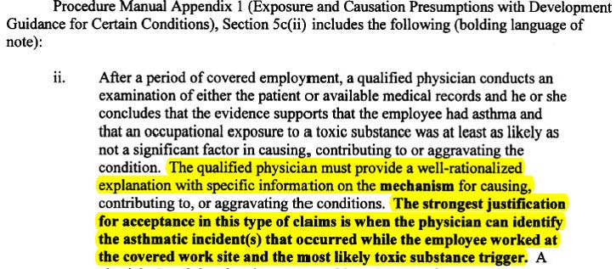
The Advisory Board had 4 Recommendations regarding Work-related Asthma (WRA)
1) The DOL and Advisory Board are in general agreement regarding the first 3 recommendations, which related to the definition of occupational asthma and the diagnosis of asthma and asthma exacerbations.
2) The Advisory Board’s 4th recommendation related to concerns regarding the criteria to diagnose WRA and the related wording in the Procedure Manual (in V 4.0 Appendix I, Exhibit 15-4 (page 3 of 12):

Slide 4
DOL Responses to Board Recommendations (12/18/19)
Work-related Asthma: DOL Response

Slide 5
Advisory Board’s Response to the DOL 12/18/19 Response Regarding the WRA recommendation
1) The Advisory Board and the DOL respectfully differ in their interpretations of “a toxic substance”.
2) The following alternate wording is recommended for the red-underlined text: “The qualified physician must provide a well-rationalized explanation for his or her conclusions. The strongest justification for acceptance ……
Rationale: Since the mechanisms by which a toxic substance(s) causes asthma are poorly defined, most qualified physicians will not be able to provide this information.
2)
1)

