Slide 1
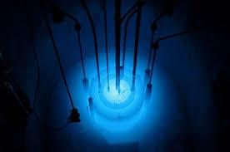
The Reactor
Of Trauma
From Theory To Practical:
Vicarious Trauma In One Organization

Slide 2
Key Takeaways
Identify vicarious trauma within an organization
Application of the S.E.L.F model within organization
Use of “Universal Precautions” to work with trauma
Vicarious Trauma as opportunity of healing
Imagination and images to stimulate

Slide 3

Grit, Determination

Slide 4
Hopeworks
The Beginning
Good People, Wanting To Do Good Work
Something had happened

Slide 5
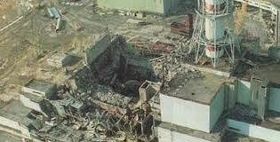
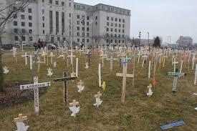
Camden Context
Up to a 70% dropout rate
50% of population is 25 or below
80% of youth live below poverty line
68% of all households are lead by single parent
1 out of 75 people assaulted
Unemployment is close to 20%

Slide 6
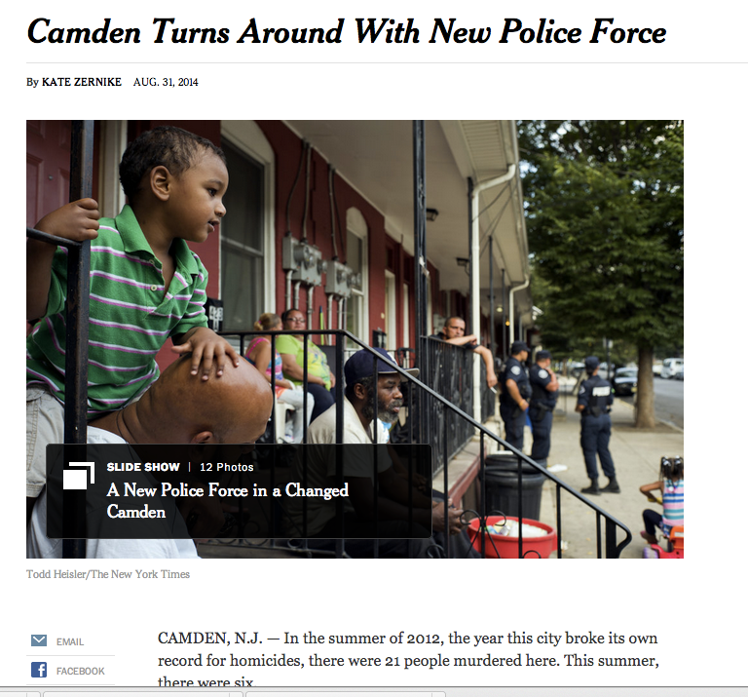
Parallel Process
Yet recent headlines suggest otherwise:
  Upgrade In Troubled City’s Credit Rating Gives Camden New Hope
Not a-contextual
  Toxic stress and ways of community
  coping will show up in our org
Requires Focus On Injury
Impact On Us As Organization
  We “Organize”
  We Respond To Our Environment

Slide 7
How measure impact?
ACES
Brain Health
Attachment

Slide 8
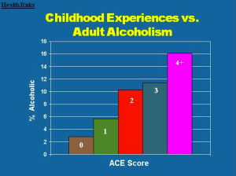
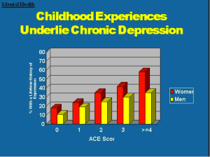
ACES
History
Who Is Safer?
Recovery from talking about what happened
Surprised

Slide 9
What Happened?
Key shift from “Why” to “What Happened?”
Connected to history
Value that behavior has meaning and purpose
  For individual
  For organization

Slide 10
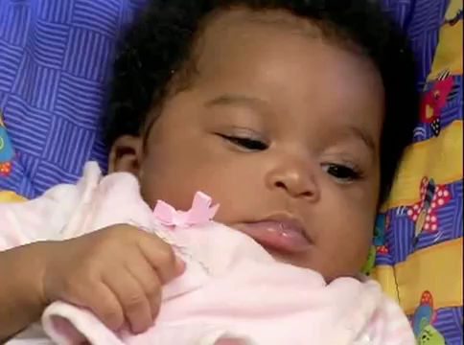
Still Face

Slide 11
Still Face In Organizations
The Good, The Bad The Ugly: Still Face
Headlines vs context
  Camden Turning Corner vs Ongoing Toxic Stress
Group Of People
  Growth, need safety
  Don’t get it, what happens as an organization?
Triggers, Reenactment (Coping)
  Silos, poor attendance, crazy emails, lack of staying in role, not liking our clients/youth/
  Fundamental belief is that “if they change, it will be better”

Slide 12
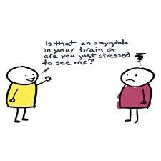
Brain Health
Not responding is a response! Impacts brain
Brain adapts—-
  Amygdala
  Strong survival behaviors become made
  Connected to “Still Face”,

Slide 13

What Happened Lunch?

Slide 14
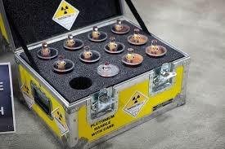
Attachment: Organizations
History is with us
We carry our history forward: Good, Bad, Ugly
Bring our own plutonium (ACES) to work
  Contained and useful? Chernobyl
  Reenactment
Familiar of emotional disregulation is connection

Slide 15
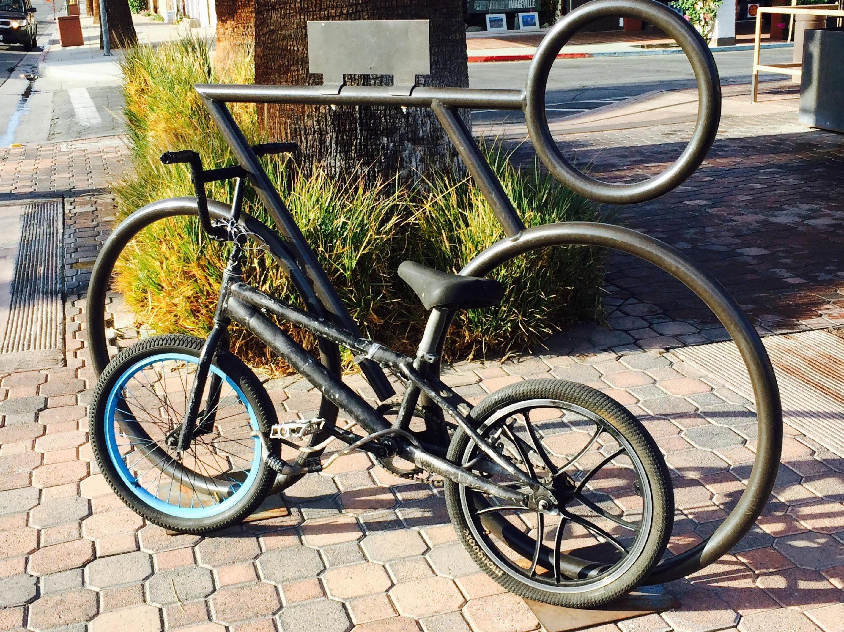

Slide 16
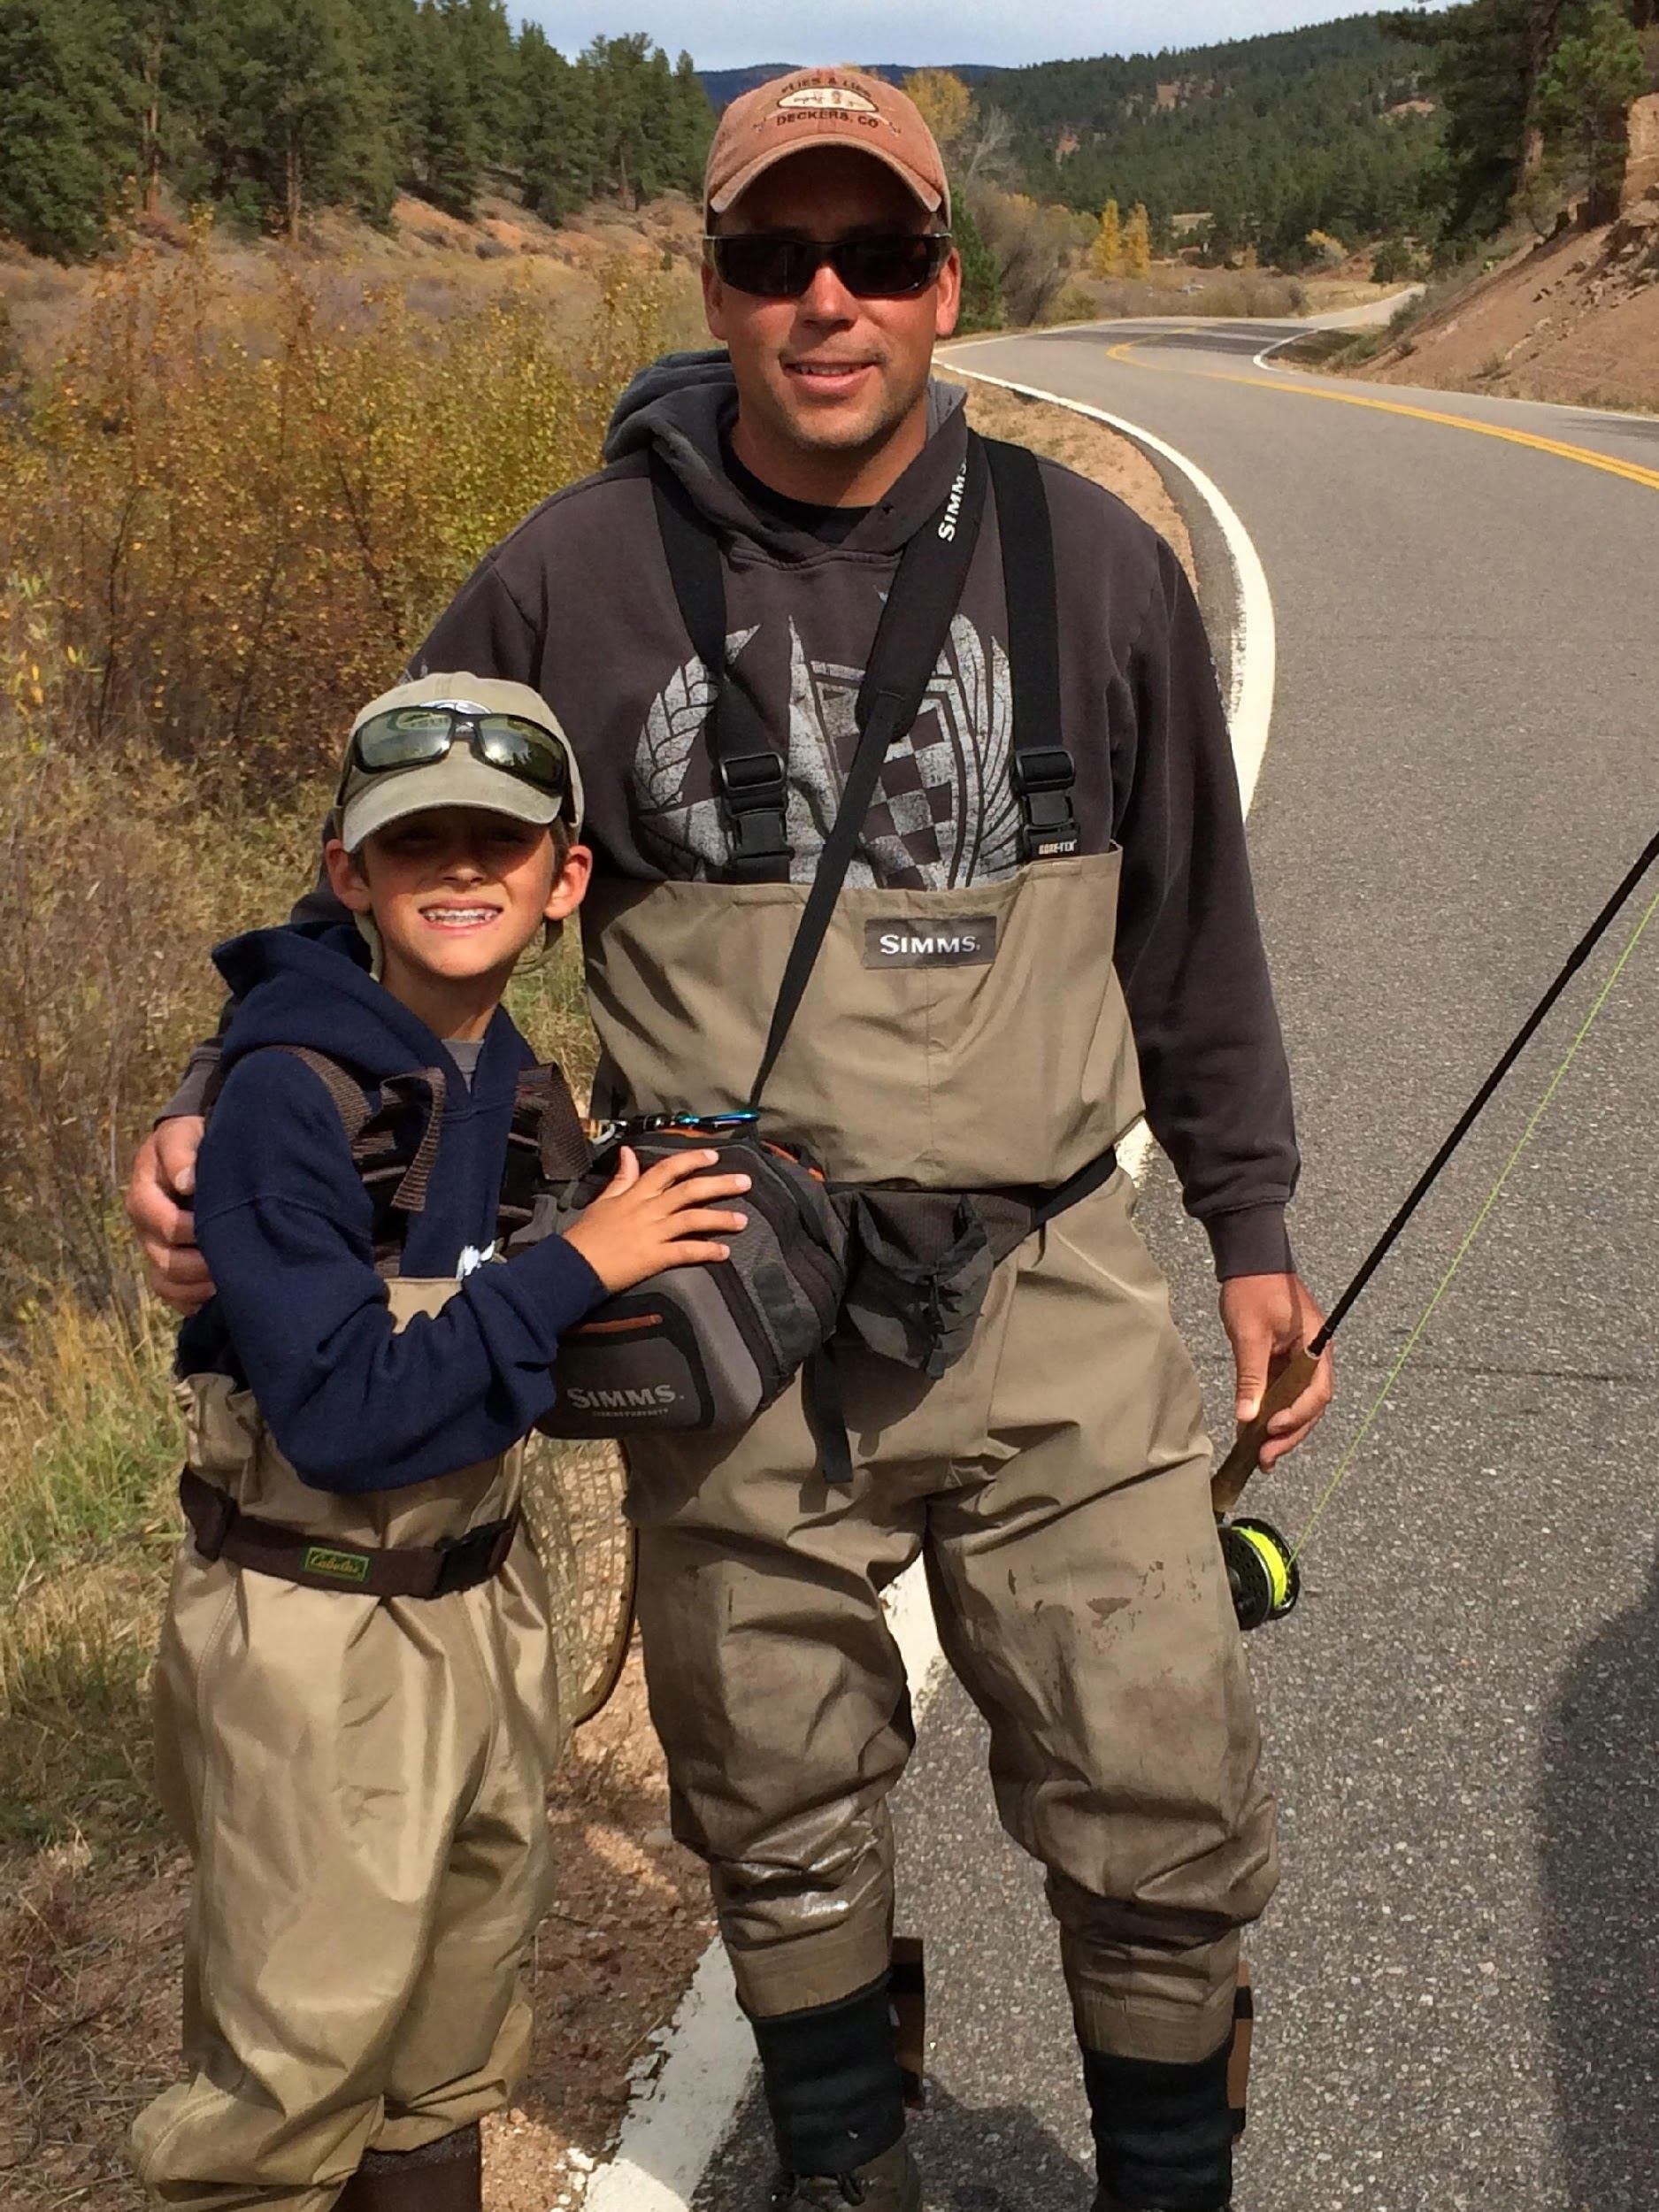

Slide 17
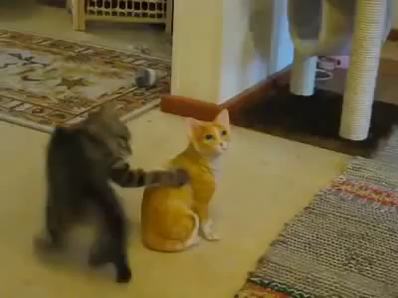
Disruptive Attachment:
Are things there?

Slide 18
Disruptive Attachment: Organization
Working In Space Where Vulnerability Is Triggering
Looking For Patterns Of Behavior
What Does Success Look Like?
  Vulnerability will trigger disruptive attachment
  Do we train for this?

Slide 19
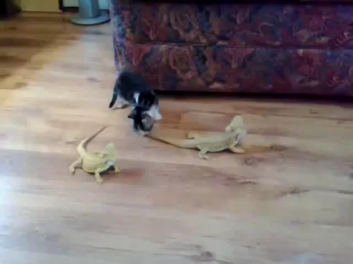
Hyper-Arousal

Slide 20
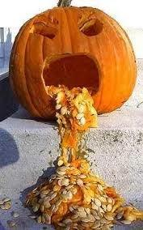
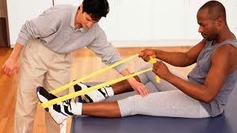
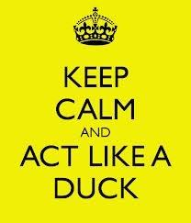
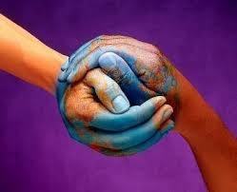
Key Images
Reactor/Radiation: What has happened to me
Vomit
  Not Vomit Adverse
  Smelly, makes others sick, different kinds
  Act Like A Duck
Hope Is Sweaty
  Reflection, Persistance
Physical Therapy
  Partnership
Healing
  Heal as we are
  Empathy

Slide 21
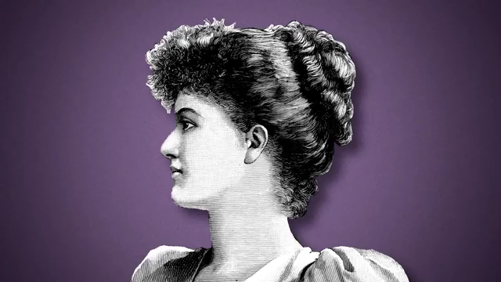
Radical Empathy

Slide 22
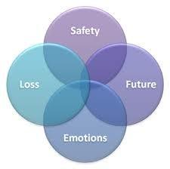
Empathy:
S.E.L.F. Framework
Safety
Emotion Management
Loss
Future

Slide 23
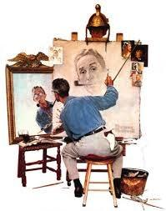
S.E.L.F. Framework
Framework for creating connection
    Framework we use to help us identify radiation
    To maintain our own integrity in the midst of toxic-stress
    Emphasis is on dynamic, not diagnosis
    Future/Mission driven
    No future, we end up with fancy
      Connecting through survival to future
      Dream
Acknowledging that I bring my own plutonium to work
Heavy on trauma triangle
  Rescuer, Victim, Persecutor
  Helpful for knowing when something is up

Slide 24
Universal Precautions
Key aspect: Personal—> Flows to the Org
    Emphasis On Trauma History (Use Of Self As Framework)
    Trauma Triangle: Victim, Persecutor, Rescuer
    Recognize the personalization vs. dynamic
Safety Plans
Self-Care Plans
Community Meetings (Huddles)
Red Flag Meetings
Shared Management

Slide 25
Community Meetings
Normalize feelings
Transparent naming
Simple
Not judging or fixing
Structure—goal and resource

Slide 26
Safety Plan
Immediate
Close to Us
Name that which helps me
Empowering, I can change the tune here

Slide 27
Red Flag Meetings
Used When Get Stuck
  Feeling Unsafe
  Lack Of Clarity
  A way to pause, to move from triangle to dynamic
  A way to ask “How is behavior helpful?”
  Use of SELF

Slide 28
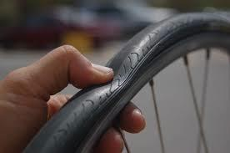
Self-Care Plans
Long Term Care
Building “muscle” to do the work
Tires
  Not Over Inflated
  Not under (hard, hard, hard)

Slide 29
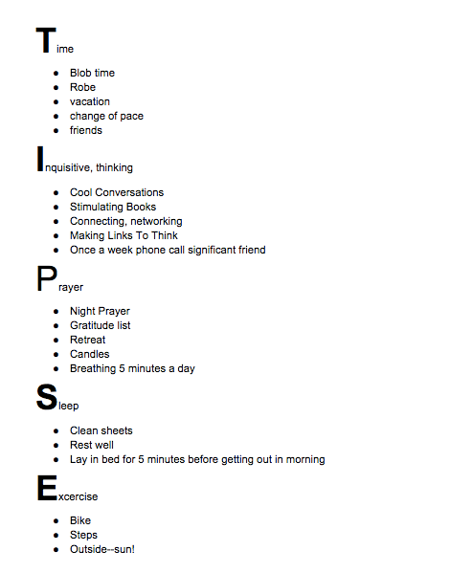
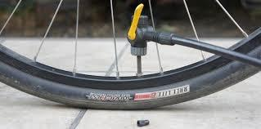
Self-Care Plan Example

Slide 30
Shared Management
Ability to join management team
Multiple roles
  work on role clarification
  SELF framework from different role
Transparent, democratic, growth

Slide 31
Key Takeaways
Name The Injury
Vicarious Trauma To Be Expected
Vicarious Trauma As Opportunity To Engage History
Expect To Be Irradiated
Exposure Requires Organizational Culture Changes in order to remain present at point of trauma/irradiation
Structure Is Key
  Universal Protections Provide This
Innovation At Point Of Vomit—connection happens!

Slide 32
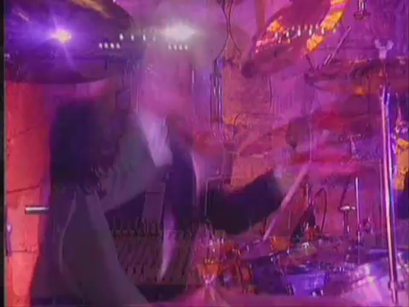
Imagine The Healing:

