Slide 1
Creating trauma-informed communities
Using A Health Approach to Prevent Violence and Address Trauma
Notes:
The Cure Violence logo is in the upper left hand corner. It is a rectangular shape, with the word CURE at the top of the rectangle and the word Violence at the bottom of the rectangle. The top section is colored light blue and the bottom is dark blue. The dark blue lower section looks like vertical, haphazard paintbrush strokes.

Slide 2
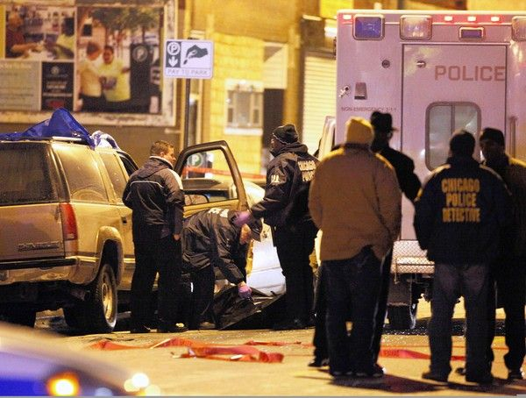
In many US cities, HOMICIDE is the LEADING CAUSE OF DEATH
Notes:
The slide shows a large picture of Chicago Police and a medical examiner responding to a violent incident.
In a large, blue oval superimposed on the picture is the text: In many US cities, homicide is the leading cause of death

Slide 3
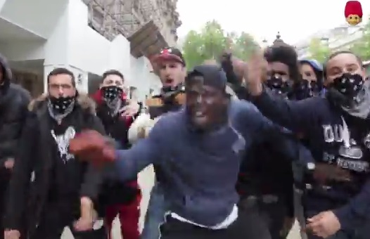
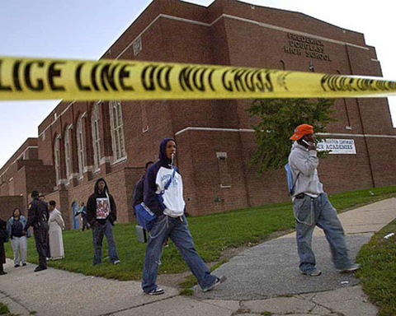
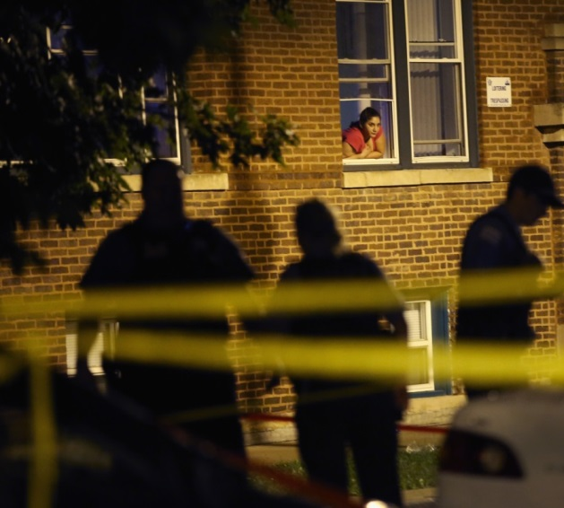
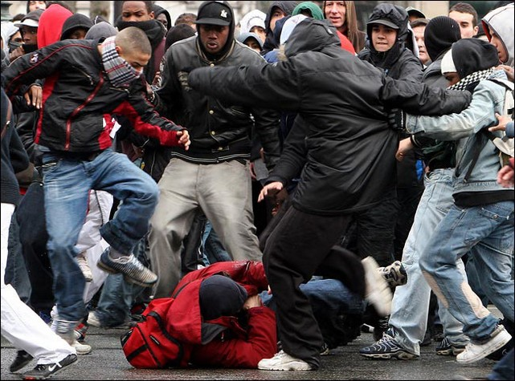
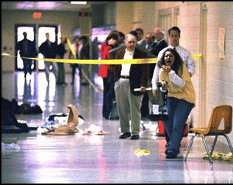
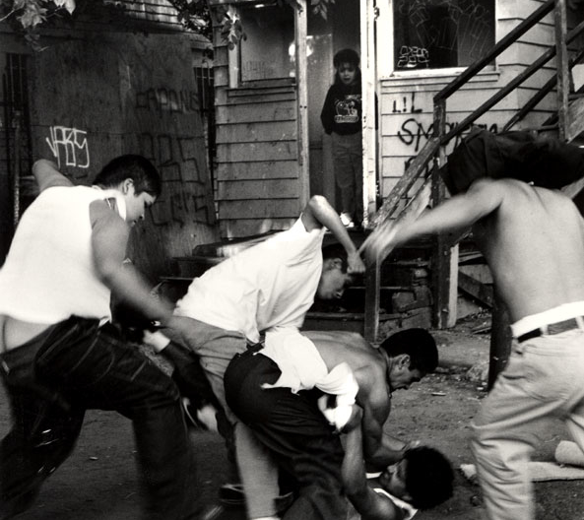
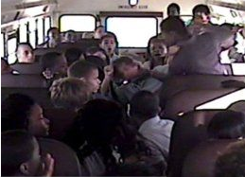
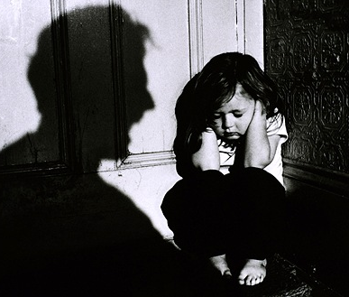
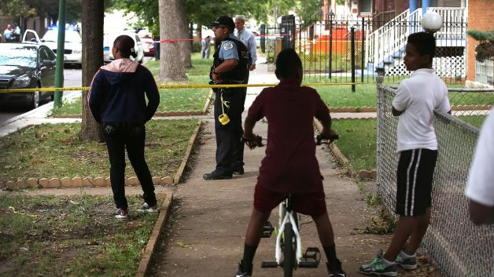
Notes:
Slide shows nine (9) violent images
Row 1 (from left to right):
First image is of alleged gang members acting aggressively
Second image shows students walking by a school with police tape across the image
Third image shows a person looking out the window of their home as police tape off a crime scene
Row 2 (from left to right)
First image is of a fight where a group of boys is gathered around a person on the ground and appear to be kicking him
Second image is of a school hallway that has police tape across it and several adult men and women in the hall. In the forefront of the picture is a woman screaming
Third image is of a group of individuals fighting in front of a house. Four men are attacking a man who is on the ground
Row 3:
First image is of two boys (one on a bicycle) and a woman, standing on a sidewalk that is taped off with police tape as a police officer stands near by
Second image is of a fight on a school bus filled with young children. One boy his hitting another boy as a group of approximately 20 boys and girls watch
Third image is of a small female child huddled in a corner with her hands of her ears and her eyes shut. There is a shadow of a man yelling at her.

Slide 4
Chronic Exposure to Community Violence
Associated with 30x Risk of Perpetrating
Probability of Perpetrating Violence
No, Low, or Moderate
Exposure to Violence
Chronic Exposure
to Violence
Spano, Rivera, & Bolland 2010
Notes:
A bar chart is title: Chronic Exposure to Community Violence Associated with 30x Risk of Perpetrating
The left side of the graph shows the Probability of Perpetrating Violence
The bottom of the graph shows level of exposure to violence
The first bar is colored in orange. It is at approximately 1 on the chart. It depicts the likelihood of perpetuating violence for individuals with No, Low, or Moderate Exposure to Violence
The second bar is also colored in orange. It is at 30 on the chart. It depicts the likelihood of perpetuating violence for those chronically exposed to violence

Slide 5
Risk of doing violence is related to exposure to violence
and is dose dependent
HIGH EXPOSURE
Violent Behavior Score
INTERMEDIATE EXPOSURE
LOW
EXPOSURE
Age
(Adapted from Spano, 2010)
Notes:
A line graph is titled: Risk of doing violence is related to exposure to violence and is dose dependent
The left side of the graph show the Violent Behavior Score (range is 0-6)
The bottom of the graph shows Age (range is 11-17)
There is a blue line at the bottom of the graph at zero on the left side that runs across the entire length of the age axis. It is denoted as “Low Exposure”
There is a red line from beginning approximately at 1.5 for Age 11, below 1 for Ages 12 & 13 and then climbing up from 1 at age 14 and increasing to approximately 2.5 at age 17. It is denoted as “Intermediate Exposure”
There is another red line that begins at the number 3 (on the left axis) and climbs, reaching a little over five by age 17. It is denoted as “High Exposure”

Slide 6
TRANSMISSION OF VIOLENCE
Exposure to
Violence
Violence
Source: Mullins et al. 2004; Devries et al. 2011
Notes:
The slide shows an animated graphic
It resembles a graph without graph lines
On the left graph axis there is a downward facing arrow listed as Exposure to Violence
On the bottom graph axis there is an area pointing right listed as violence
Starting where the axes connect there is a dotted red, diagonal arrow

Slide 7
Health Approach
Violence behaves like a contagious disease (epidemic)
Treating violence like an epidemic gets results in communities
*Do No Harm - Poised to better engage individuals and communities and reduce risk of re-traumatization

Slide 8
The Cure Violence Strategy for Reducing Violence
DETECT AND INTERRUPT POTENTIALLY VIOLENT CONFLICTS
TREAT THOSE AT HIGHEST RISK FOR INVOLVEMENT IN VIOLENCE
GROUP AND COMMUNITY NORM CHANGE
DATA AND MONITORING
TRAINING AND TECHNICAL ASSISTANCE
Notes:
Slide title is: The Cure Violence Strategy for Reducing Violence
There is a SmartArt graphic showing five horizontal boxes, each with pictures
Below each box is its associated text
From left to right the image and corresponding text is as follows:
Image 1: Clip art, outline of two white figures that appear to be arguing and are being separated by a third orange figure who is standing between them
Text 1: Detect and Interrupt Potentially Violent Conflicts
Image 2: a portion of a clock that reads, “Time to heal”
Text 2: Treat those at highest risk for involvement in violence
Image 3: Clipart of a bull horn
Text 3: Group and Community Norm Change
Image 4: Clipart of a data system (cloud of images associated with data – facebook log, computer, gears, magnifying glass…)
Text 4: Data and Monitoring
Image 5: ClipArt image of the outline of a human head with interlocking gears
Text: Training and Technical Assistance

Slide 9
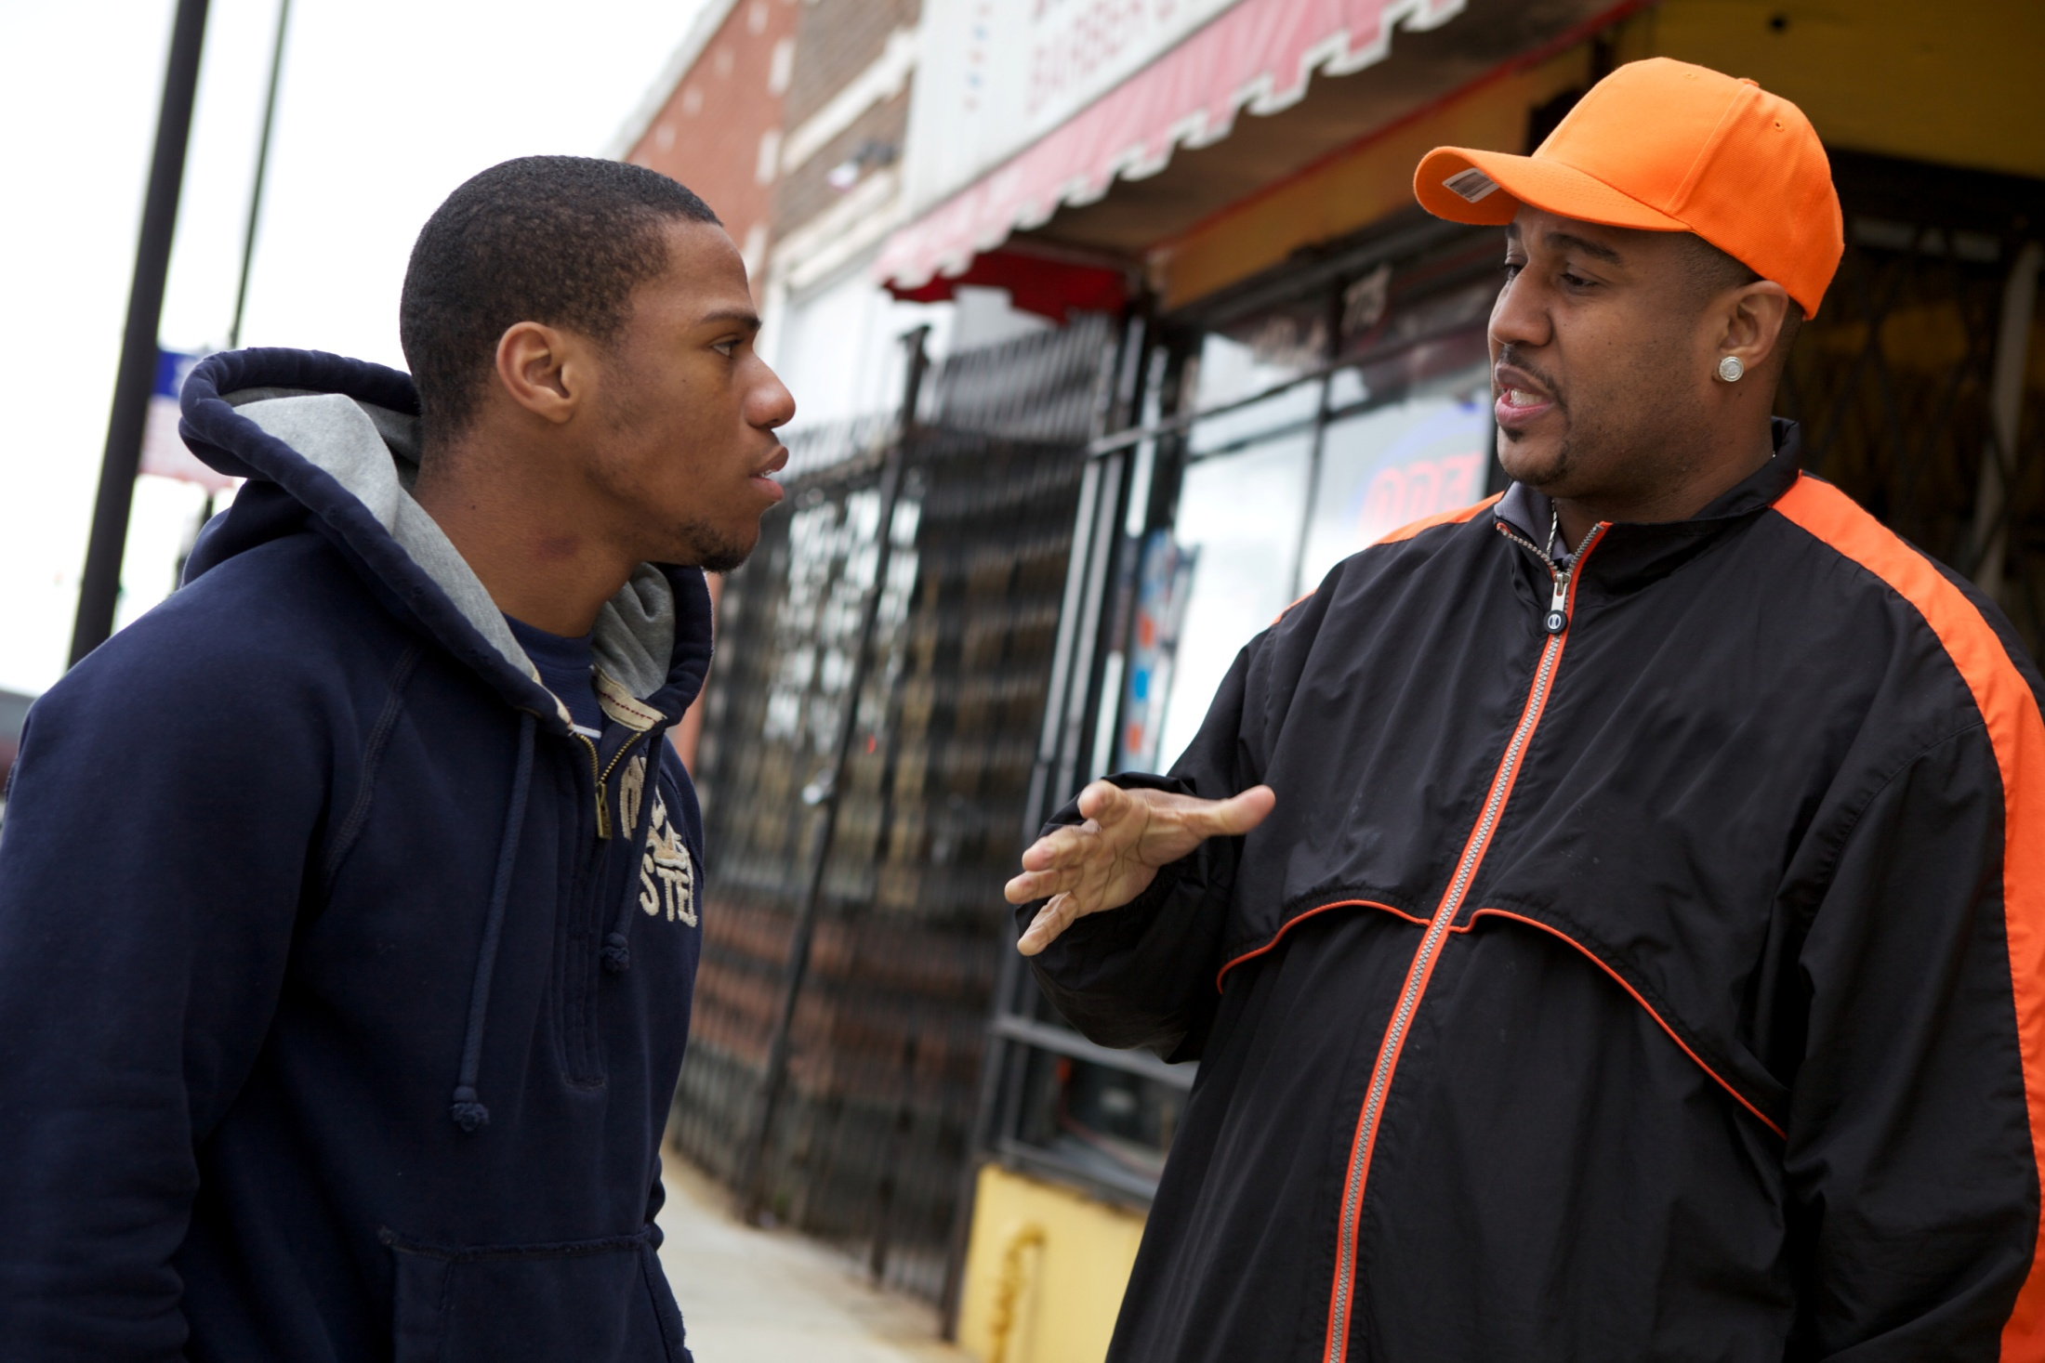
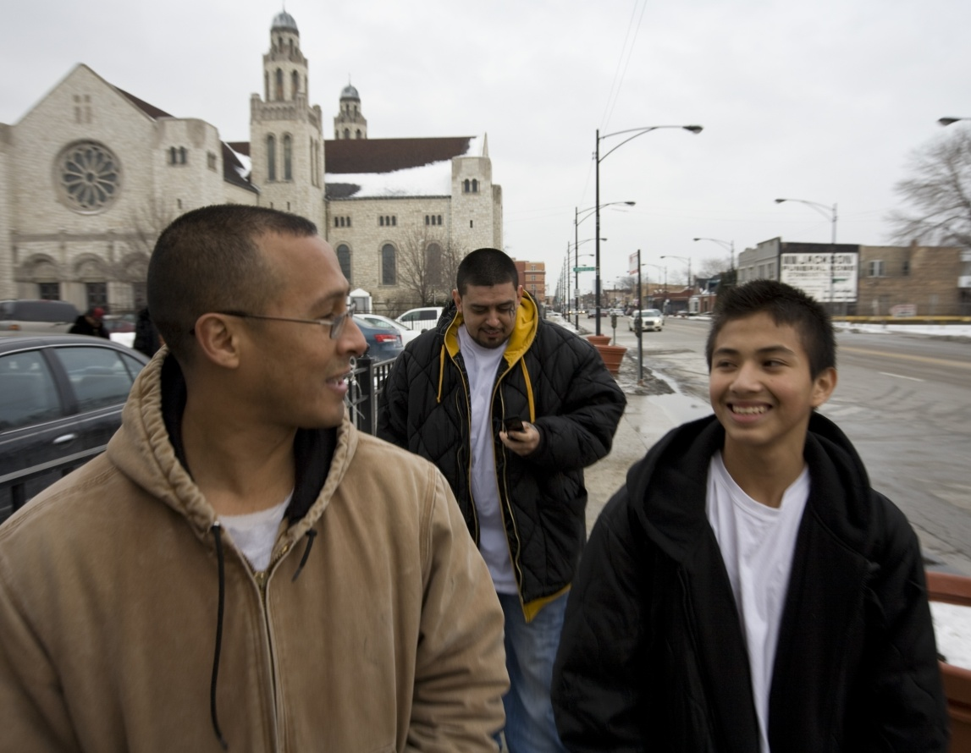
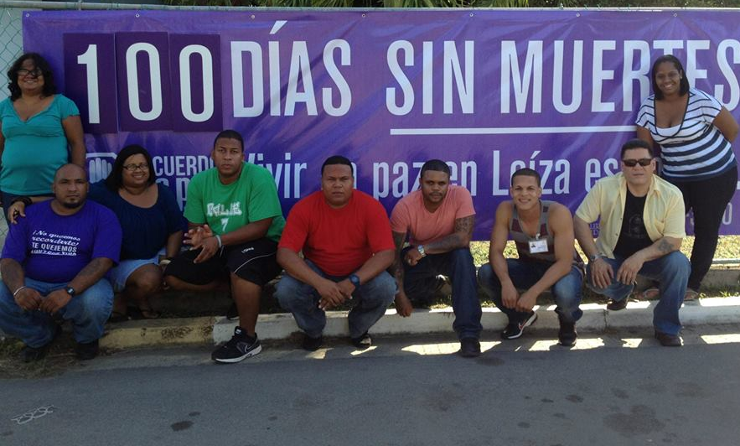
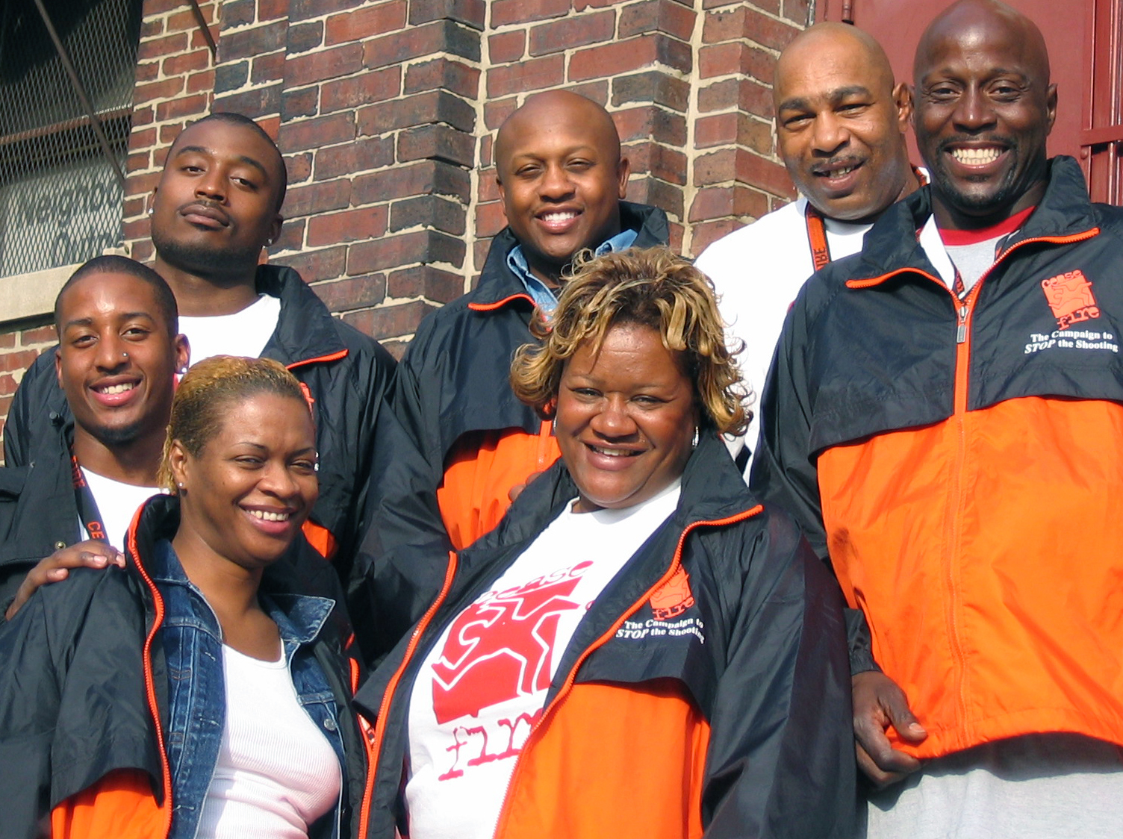
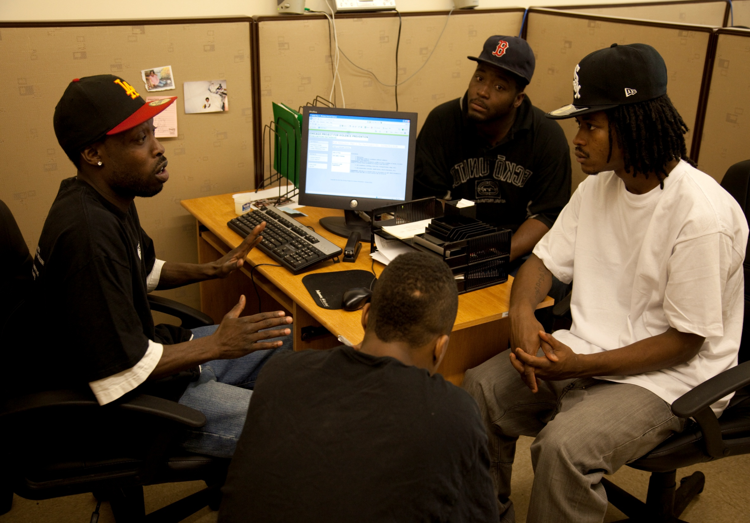
Credible Messengers
Notes:
Slide title is: Credible Messengers
There are four images on the slide (two rows of two)
Row 1, Image 1 is of an African American staff member talking to an African American young adult
Row 1, Image 2 is of two Latino men and a smiling, male, Latino young adult walking down a city street
Row 2, Image 1 is of a group nine Latino men and women sitting on a curb, posing in from of a banner that reads, “100 Dias Sin Muertes” (translation = 100 days without killings)
Row 2, Image 2 is of a group of seven African American men and women smiling for a picture. They are dressed similarly and their clothing is the uniform of the organization they work for.

Slide 10
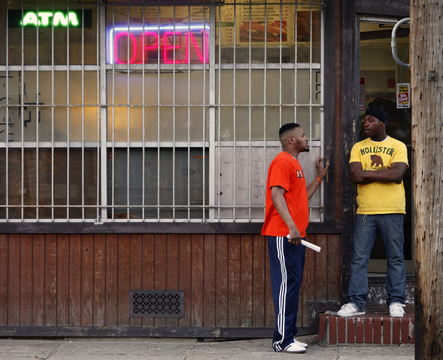
Qualities of a Credible Messenger
Able to relate to highest risk
Lived experience
Able to influence
Connected to the community
Opinion leaders
Notes:
Slide title: Qualities of a Credible Messenger
To the right of the text there is a picture of an African American man in an orange shirt speaking to a younger African American man who is standing in the doorway of a business

Slide 11
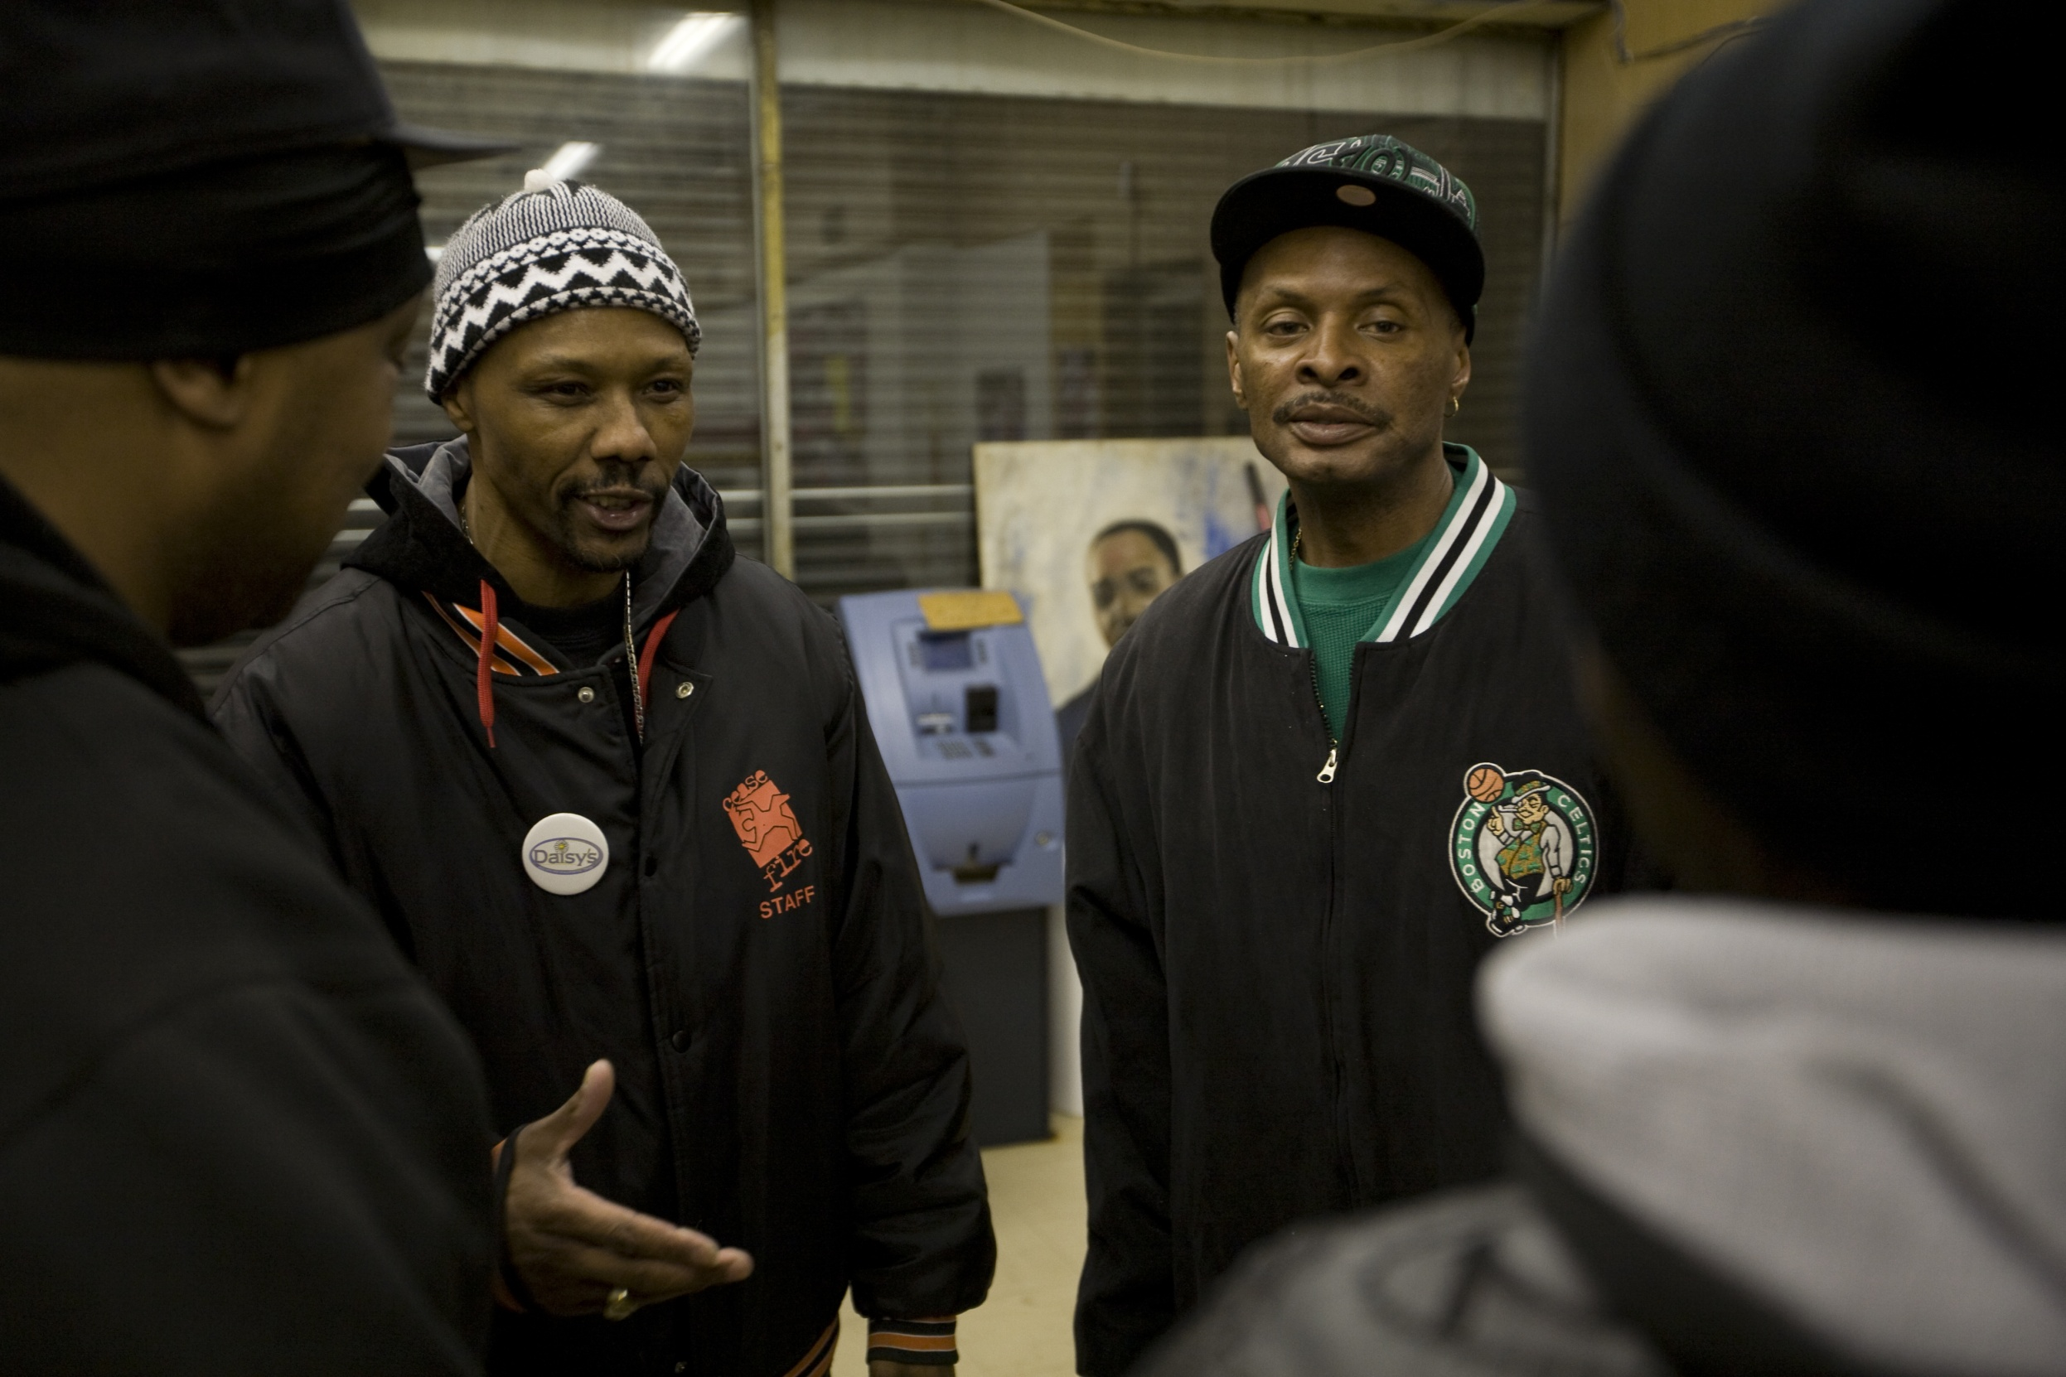
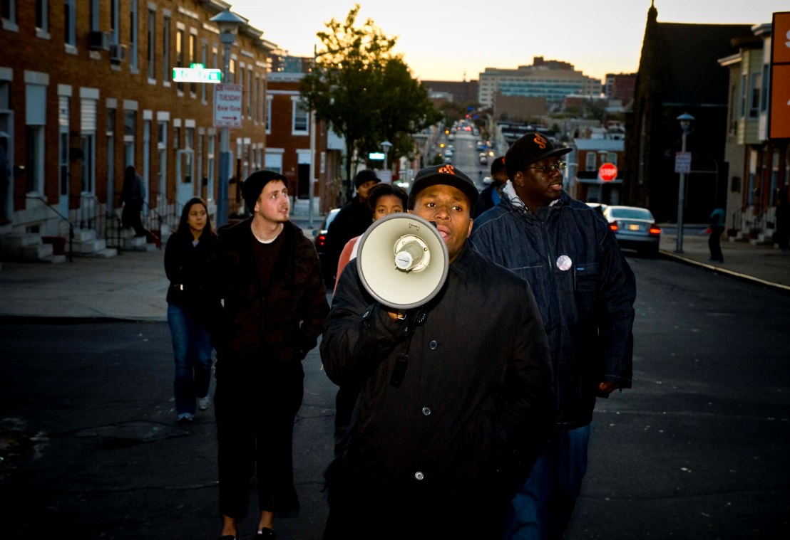
Provide:
New Skills
New Information
New Language
Promote: Behavior & Norm Change
Notes:
To the left of the text are two pictures
The top picture is of a group of four African American men standing together (two facing the other two), having a conversation inside of an office
The bottom picture is of a group of people marching down a street. Leading the group is an African American man speaking into a bullhorn

Slide 12
THE STRATEGY
Interrupt Transmission
Stop violent events before they happen
Identify and change the thinking of highest potential transmitters
Reduced Violence & Reduced Exposure
Reduce number of violent individuals
Change Community Norms
Create social pressure to stop violence
Notes:
The slide displays a diagram. The first column has 3 orange boxes with “Interrupt Transmission” in the 1st box, “Identify and change the thinking of highest potential transmitters” _ in the 2nd box, and “Change Community Norms” in the 3rd box. Each orange box has an arrow protruding from the center right of each box, connecting the orange to the next column of boxes. These three boxes are light blue. In the 1st box the text reads “stop violent events before they happen.” The second box contains the text “Reduce number of violent individuals.” The third box contains the text “Create social pressure to stop violence.” Each box in this column has an arrow protruding from the center, right. All of the arrows point to one final box that is pale blue. The final box contains the text “Reduced Violence & Reduced Exposure.”

Slide 13
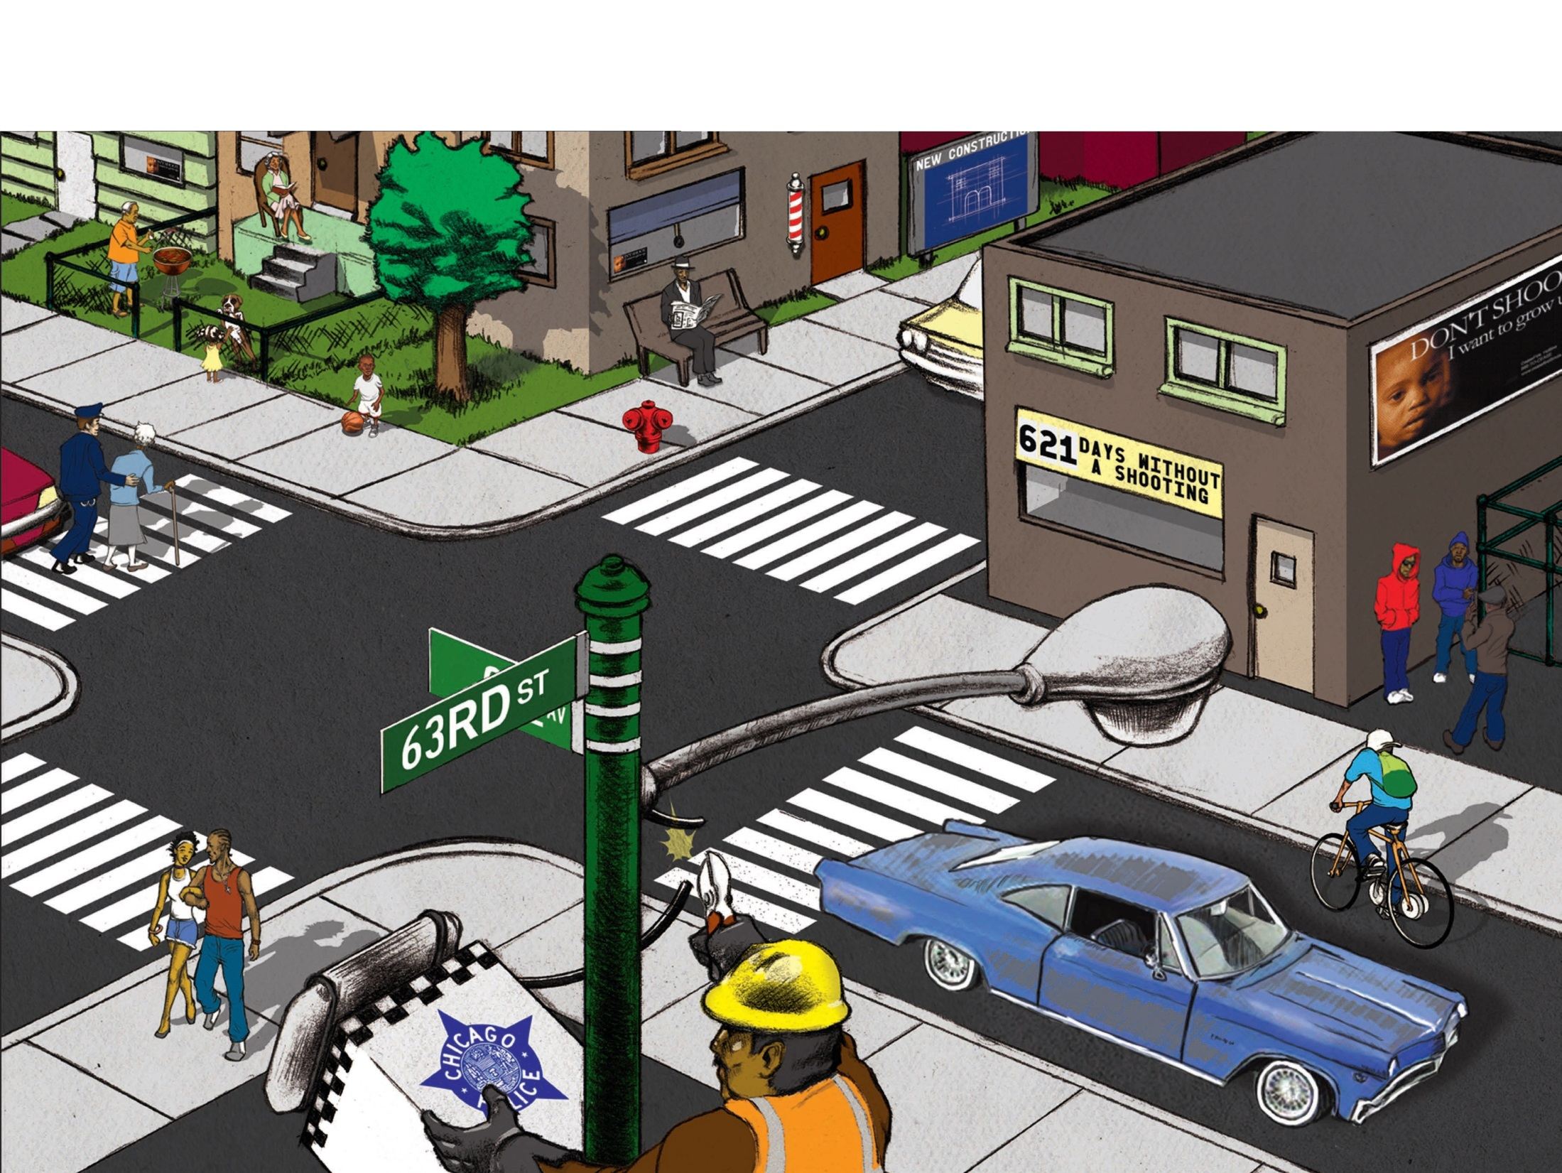
Our Goal
Notes:
The slide title is: Our Goal
The slide is a cartoon styled drawing of a intersection of streets in a neighborhood. In the image are the following:
a building with a sign that says “621 days without a shooting”
A man sitting outside of a barbershop reading a news paper
Children playing ball
A police officer assisting an elderly woman across the street
A man and woman holding hands as the walk down the street
A young man riding a bike
A group of three men standing outside of building talking
A woman sitting on her front porch
A sign on a building that says “New Construction”
In the forefront is the street sign (63rd St)/light post and a city worker has climbed it and is removing a Chicago Police Department camera

Slide 14
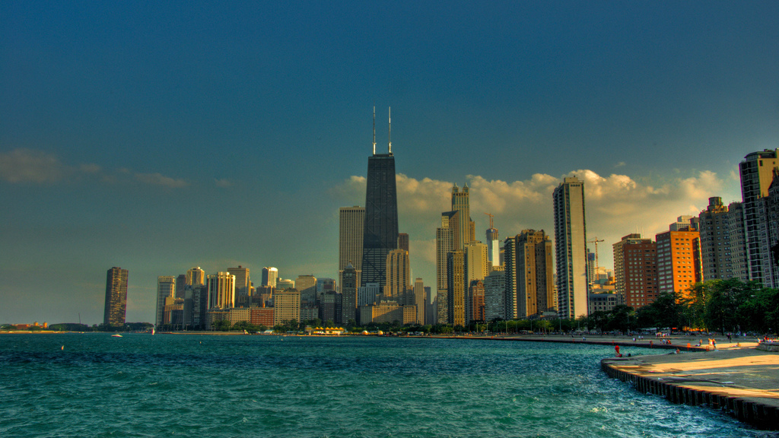
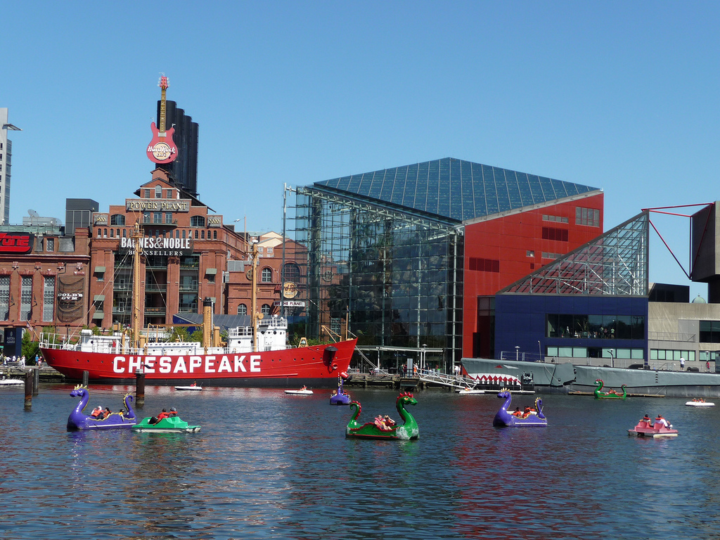
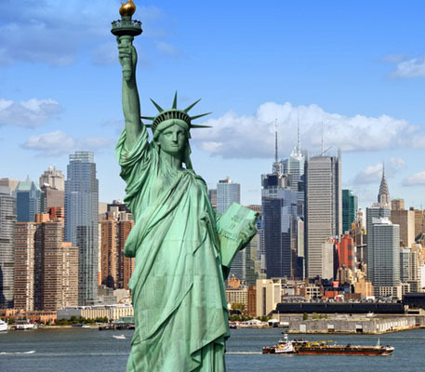
arrows
Chicago
Shootings
and
Killings
New York City
Shootings
Baltimore
Killings
-56%
-20%
41% - 73%
Notes:
The slide shows three separate blocks of pictures
The first is a light blue arrow pointing downwards imposed on an image of the Chicago lakefront. At the top of the arrow is the U.S. Department of Justice seal. The text within the arrow is: Chicago Shootings and Killings, 41%-73%
The second is a dark blue arrow pointing downwards imposed on an image of Baltimore’s Inner Harbor. At the top of the arrow are logos for the CDC, Centers for Disease Control and Prevention, and Johns Hopkins University. The text within the arrow is: Baltimore Killings -56%
The third is a dark blue arrow pointing downwards imposed over a picture of New York City’s skyline. At the top of the arrow are the logos for the BJA, Bureau of Justice Assistance, U.S. Department of Justice and the Center for Court Innovation. The text within the arrow is: New York City Shootings -20%

Slide 15
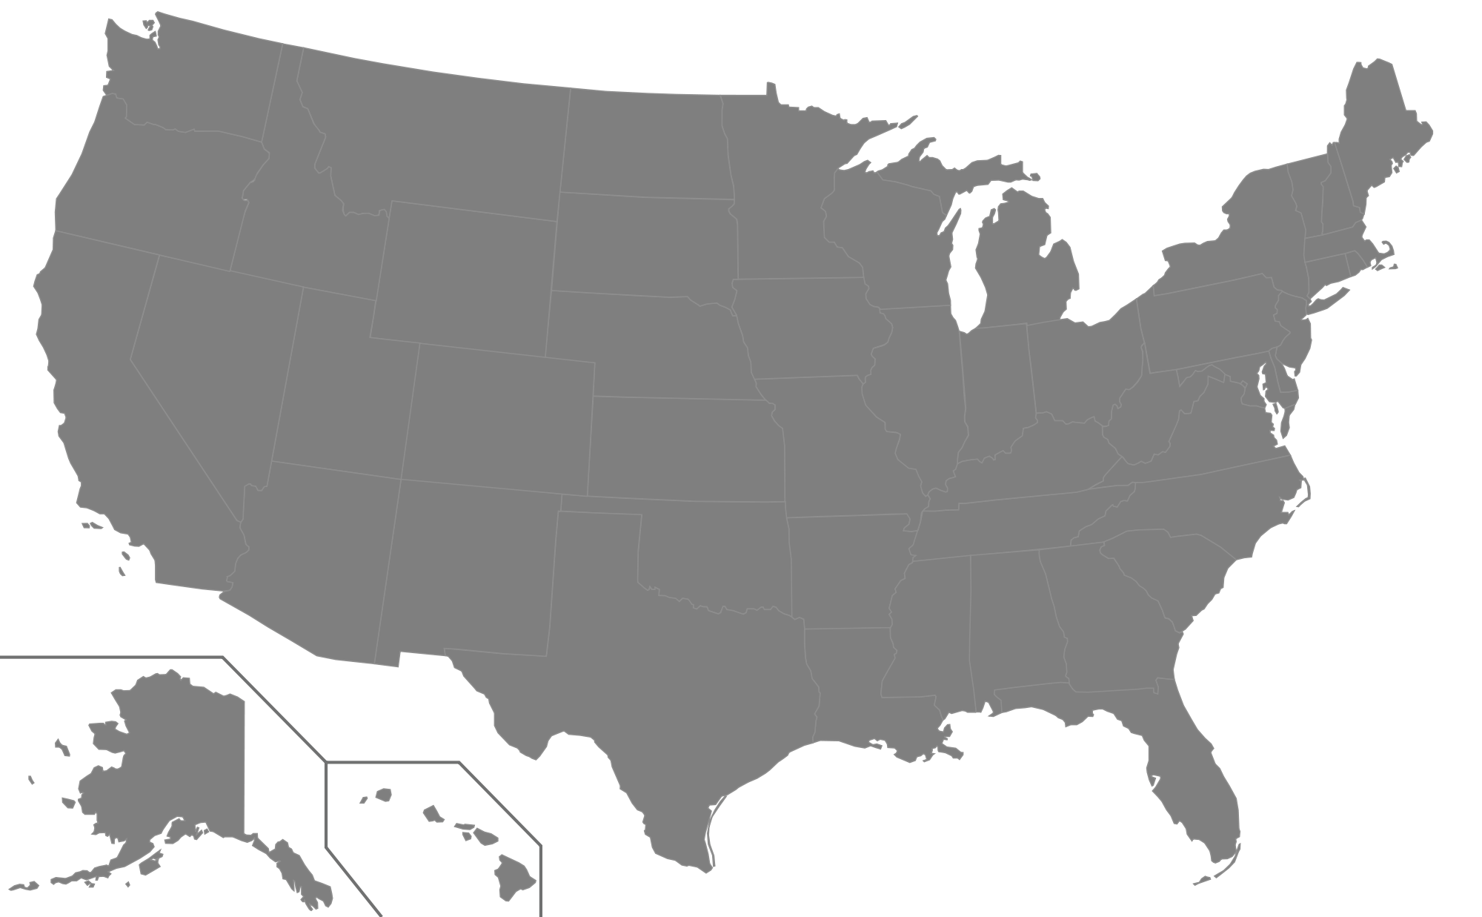
CURE VIOLENCE NATIONAL ADAPTATION PARTNERS September 2015
SEATTLE
SYRACUSE
TROY
MINNEAPOLIS
MILWAUKEE
ROCHESTER
ALBANY
NORTH CHICAGO
BUFFALO
MT VERNON
MAYWOOD
YONKERS
CHICAGO
NEW YORK CITY
HEMPSTEAD
SAN FRANCISCO
ROCKFORD
CICERO
PHILADELPHIA
CAMDEN
RICHMOND
SPRINGFIELD
BALTIMORE
WILMINGTON
OAKLAND
KANSAS CITY
EAST ST. LOUIS
LOS ANGELES
ST. LOUIS
DURHAM
SAN ANTONIO
NEW ORLEANS
TALLAHASSEE
ADAPTATION PARTNERS
MIAMI
NEW ADAPTATION PARTNERS
Loiza, PR
POTENTIAL PARTNERS
POTENTIAL HEALTH APPROACH PARTNERS
Notes:
Slide title: Cure Violence National Adaptation Partners – September 2015
There is a map of the United States
On the maps are orange, yellow, blue, and green dots over certain cities. Details are as follows:
Orange Dots denoting cities/areas that have adapted the approach. They are:
Albany, New York
Mt. Vernon, New York
Yonkers, New York
New York, New York
Philadelphia, Pennsylvania
Baltimore, Maryland
Chicago, Illinois
North Chicago, Illinois
Maywood, Illinois
Rockford, Illinois
East St. Louis, Illinois
Kansas City, Missouri
New Orleans, Louisiana
Oakland, California
Loiza, Puerto Rico
Yellow dots denote New Adaptions Partners. Details are as follows:
Troy, New York
Syracuse, New York
Buffalo, New York
Rochester, New York
Hempstead, New York
Camden, New Jersey
Wilmington, Delaware
San Antonio, Texas
Springfield, Illinois
Blue dots are Potential Partners. Details are as follows:
Durham, North Carolina
St. Louis, Missouri
Tallahassee, Florida
Miami, Florida
Green dots denote Potential Health Approach Partners. Details are as follows:
Milwaukee, Wisconsin
Minneapolis, Minnesota
Seattle, Washington
San Francisco, California
Richmond, California
Los Angeles, California

Slide 16
Thank youT
Thank you!
CureViolence
@CureViolence
LToscano@uic.edu
www.cureviolence.org

