Slide 1
ELECTRONIC FORMS SYSTEM (EFS)
Guide to Using EFS Preparing Form LM-3

Slide 2
ELECTRONIC FORMS SYSTEM (EFS) – LM-3
EFS is a web-based system for completing and filing Form LM-3 Labor Organization Annual Report.
This tutorial demonstrates basic features and functionality of the EFS LM-3 form. It does not contain instructions for what information should be provided on your report.
You can download a complete set of LM-3 Instructions from the OLMS website

Slide 3
System Requirements and Settings
To access and use the EFS, OLMS recommends you use one of the following browsers:
Microsoft Edge
Google Chrome –Version 7.0 or higher

Slide 4
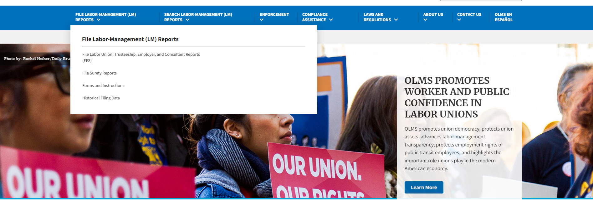
Accessing the System
Navigate to the OLMS Website and select FILE LABOR-MANAGEMENT REPORTS, then from the drop-down menu, select the “File Labor Union, Trusteeship, Employer, and Consultant Reports.

Slide 5
Access the OLMS EFS
From the EFS Introduction page, select on the “Access the OLMS EFS” link.

Slide 6
Accessing the System
To access the Form LM-3 in EFS, you must first register with EFS and obtain a user ID and password.
If you already have an EFS user ID and password, you do not need to register again.

Slide 7
Accessing the System – Log in
Log into EFS using your user ID and password and the filing union’s six-digit file number and unique union PIN.

Slide 8
Accessing the System (cont’d)
Once logged in, you will navigate to the “What would you like to do?” page.
Select an option from the items below to proceed.
(Please note that the only forms that you can amend in EFS are ones
that were filed using EFS.)

Slide 9
Accessing the System – Start a New Form
Select “Start a new form”
Select LM-3 from the dropdown
Note: You must change the “period covered” dates before obtaining the form!

Slide 10
LM-3 Page 1
The EFS form looks similar to the old Adobe form. Your union
information is pre-filled, as are the start-of-period figures on Statement A.

Slide 11
Navigation
You can easily move through the form by using the navigation links
to the left to go directly to a page or by scrolling through pages using
the arrows at the top.

Slide 12
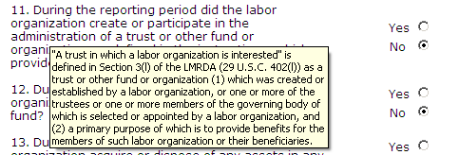
Getting Help Within the Form
The form has several built-in help functions.
Mouse-over text that displays information on what to report or how to enter data into a field is available on many items.

Slide 13
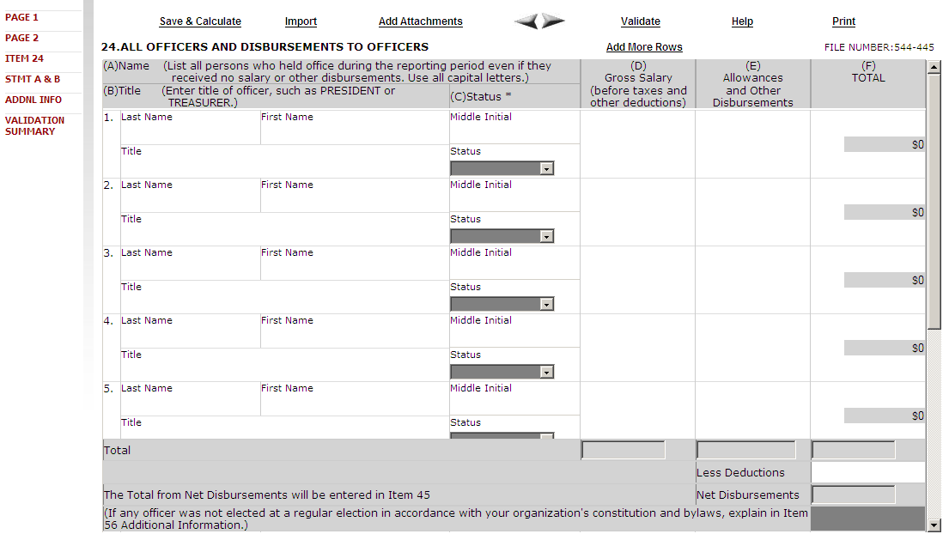
Getting Help Within the Form – Help Link
Click the “Help” link at the top of each page to open the form instructions for the current page in a new window.

Slide 14
Menu Items
The menu across the top of the form contains the following items:
Save and Calculate – Click this item to save the current page and perform all mathematical calculations. Calculations are not performed automatically because doing so would dramatically reduce the speed of the application. It is important to click Save and Calculate at regular intervals when entering data in the form. If you do not save, you will be prompted to do so when you navigate away from a page.
Import – Click this item to open the Import page for importing schedule data. You can import into any schedule by clicking this link. You do not need to have a schedule open to import data for its completion.
Add Attachments – Click this item to open the Add Attachments page where supplemental information (like a constitution and bylaws or audit report) can be uploaded. The uploaded data can then be submitted with the form.

Slide 15
Menu Items (cont’d)
The menu across the top of the form contains the following items:
Validate – Click this item to run the form validation routine, which checks the form for missing data. Each page has its own set of validations, and you will be prompted to fix these items before leaving the page if you wish. All validations must be satisfied before the form can be signed and submitted.
Help – Click this item to take you to page-specific instructions for completing the form. You can navigate through the instructions page by page, or download/print a copy from our website at: https://www.dol.gov/sites/dolgov/files/OLMS/regs/compliance/GPEA_Forms/instructions/LM-3_Instructions.pdf
Print – Click this item to open a facsimile of the electronically completed LM-3. You can save a copy of this report to your computer and share it with others who may need to prepare or review the document. You may save a copy of the final signed report prior to submission.

Slide 16
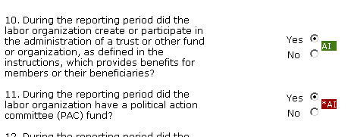
Additional Information
Throughout the form, the system will prompt you to enter additional information. You have the option to enter the information later, and the Additional Information prompt will remain red to remind you to enter additional information before submitting your report.
To enter the additional information, double-click on the AI icon and enter the additional information. The prompt will turn green, indicating that additional information has been entered.
The Additional Information Summary can be found in the left navigation pane.
AI
Additional Information entered
Additional Information needs to be entered

Slide 17
Additional Information Link
Select the ADDNL INFO link in the left navigation pane to display the Additional Information Summary page.
To go to the item, click on the blue additional information text.

Slide 18
Entering Data into the Form – Add More Rows
There are two ways to enter schedule data in the form: manually entering data and importing data.
Manual entry may require you to add more rows to a schedule. A blank schedule in EFS has ten rows. If you need more than ten rows, click the “Add More Rows” link located at the top of the schedule. This will add an additional ten rows.

Slide 19
Save & Calculate
After entering data in a schedule, click the “Save & Calculate” link to perform calculations.
The calculated totals will display in the Totals fields:

Slide 20
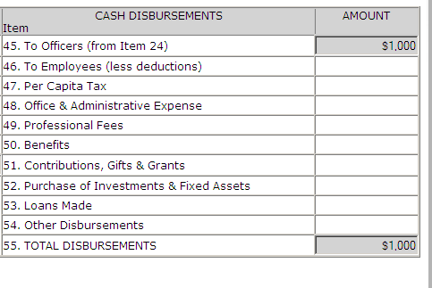
Data Carriers Forward
The schedule data carries forward to the statements.

Slide 21
Importing Data into the Form – From Link
To import data into the form, click the “Import” link on the top menu bar.
Item 24, All Officers and Disbursements to Officers, can be imported into Form LM-3. Select the import source from the dropdown menu.
A file in CVS or XML format is required to import data. These
are the same formats used in the previous Form LM-3 system.
For detailed information on creating import files, download the
Data Specification Document found on the OLMS website at: http://www.dol.gov/olms/regs/compliance/dsd.htm

Slide 22
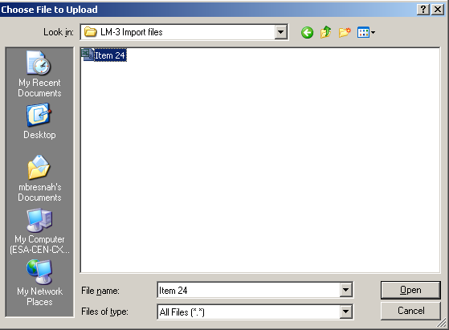
Importing Data into the Form
Select “Browse” to select the file to be imported.

Slide 23
Importing Data File
Click “Submit” to import the data file. If the import is successful, the data will display in the schedule. Click the “Save & Calculate” link before moving to the next schedule.
Note:
Large import files will import quickly, but saving the imported files to the database will take some time. An hourglass icon or the “Please wait” indicator bar shown below will let you know the system is working to save the data. Please be patient when working with large amounts of data.

Slide 24
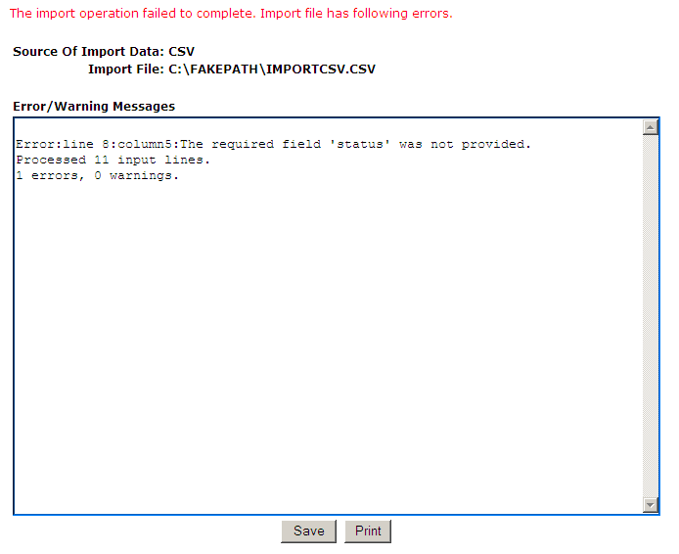
Importing Data into the Form - Errors
If any formatting problems are found in the data file during import, a list of errors needing correction will display.
You can save and print the error report to help with the correction process. All errors must be corrected before the file can be imported.
The Data Specification Document located on the OLMS website gives detailed guidance on the required data schema.

Slide 25
Attaching Supplemental Data
As with the previous forms system, EFS allows you to attach data, such as constitutions and bylaws, that may be required to be submitted with the report.
To begin the process of adding an attachment, click the “Add Attachments” link on the top menu bar.
Note: While the system does not prevent them from being uploaded, certain file formats cannot be read by our system. The following file formats can be read:
Adobe PDF
Microsoft Word
Microsoft Excel
Rich Text Format
HTML
Standard Picture formats JPEG, BMP, GIF
Text files

Slide 26
Attachments: Attaching Supplemental Data
Bylaws and Other Attachments
Select the type of attachment you want to upload. Reviewers can view attachments by selecting the check box to the left of the attachment name and clicking the open link.

Slide 27
Validation – Page Level Validations
There are two types of validations built into the form to help ensure that the correct data is being entered into the form: Page Level Validations and Form Level Validations.
Page Level Validations occur before you navigate away from a page. A pop-up message will alert you of items that must be corrected before the form can be signed and submitted.
If you click OK you can correct the item before leaving the page.
If you click Cancel, you can correct the item later. You will be prompted to make the correction during form validation.

Slide 28
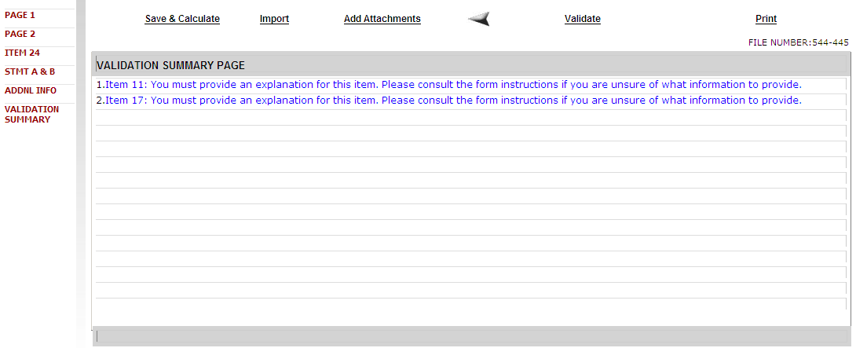
Validation – Form Level Validations
Form Level Validations occur as a final check before the form can be submitted. You must click the “Validate” link on the top menu bar.
The system will open the Validation Summary Page containing a list of items that must be corrected.
You can select each item and be taken to the page where the item can be corrected. For more information on what should be provided for
these items, consult the form instructions.

Slide 29
Signing the Form – Signature Blocks
Once all of the validation items have been corrected, the form is ready
to be signed.
The signature blocks will turn red, indicating the form can be signed.
Note: All officers who must sign the form must have established user accounts and must log into EFS with their account information to sign the form.

Slide 30
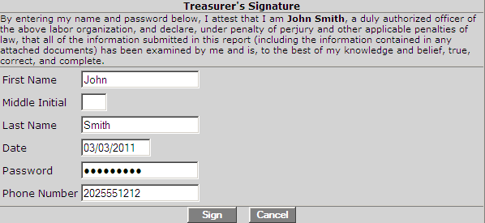
Signing the Form – Enter Password
You must re-enter your password to sign the form. By doing so, you are legally attesting that you are the person identified by name in the signature block and a duly authorized officer of the union.

Slide 31
Signing the Form
Two signatures are required to submit the report.
Once the report has been signed, if any changes are made to any fields on the form, the signatures will be removed, and the form must be validated and signed again.

Slide 32
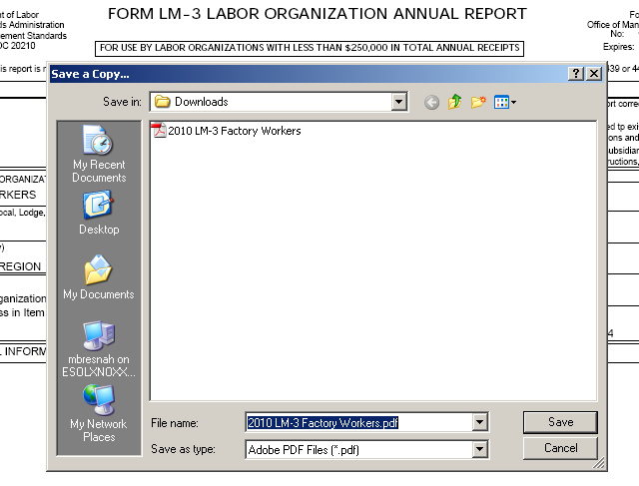
Save a Signed Copy
Select the “Print” link and click “File→ Save As” to save a signed copy of the report as a PDF to your computer. Do this before submitting the report.
Note: You can obtain a copy of the submitted report from the Online
Public Disclosure site. Please see the next section for information on this.

Slide 33
Submitting the Form
Once the signatures have been applied, the form can be submitted.
Click the “Submit” link from the top menu bar. Once the form has been processed (this may take a few minutes) a confirmation message will display:
You can print this message by going to “File→ Print,” or simply copy and paste the text from the page into an email or word processing document.
You should now be able to view your submitted report in the Online Public Disclosure Room, by using the link shown above.

Slide 34
Troubleshooting
During peak filing periods, you may experience a slowdown in saving and validating the report.
During these busy periods, you may see an error that looks like this:
Please wait a few minutes and try again. However, if you continue to experience the problem, please contact our technical support desk.
See the next page for information on how to get help.

Slide 35
Getting Help
If you experience difficulty using EFS, please contact OLMS Form Technical Support toll-free at: 1-866-401-1109
This PowerPoint presentation and other information regarding EFS can be found on our website at the following URL:
http://www.dol.gov/olms/agencies/regs/compliance/efs/efsintro.htm
If you have additional questions or comments please contact OLMS: email OLMS at olms-public@dol.gov or contact your local
OLMS District Office

