Slide 1
Overview of O*NET Portals
O*NET OnLine
My Next Move
My Next Move for Veterans
Mi Proximo Paso

Slide 2
What’s in O*NET?
Knowledge Interests
Skills Work Styles
Abilities Work Values
Tasks Tools & Technologies
Work Activities Related Occupations
Work Context
Supplemented with:
Education, Training and Experience Required
Wages
Employment Trends/Outlook
Links to resources on job openings, credentials, education/training

Slide 3
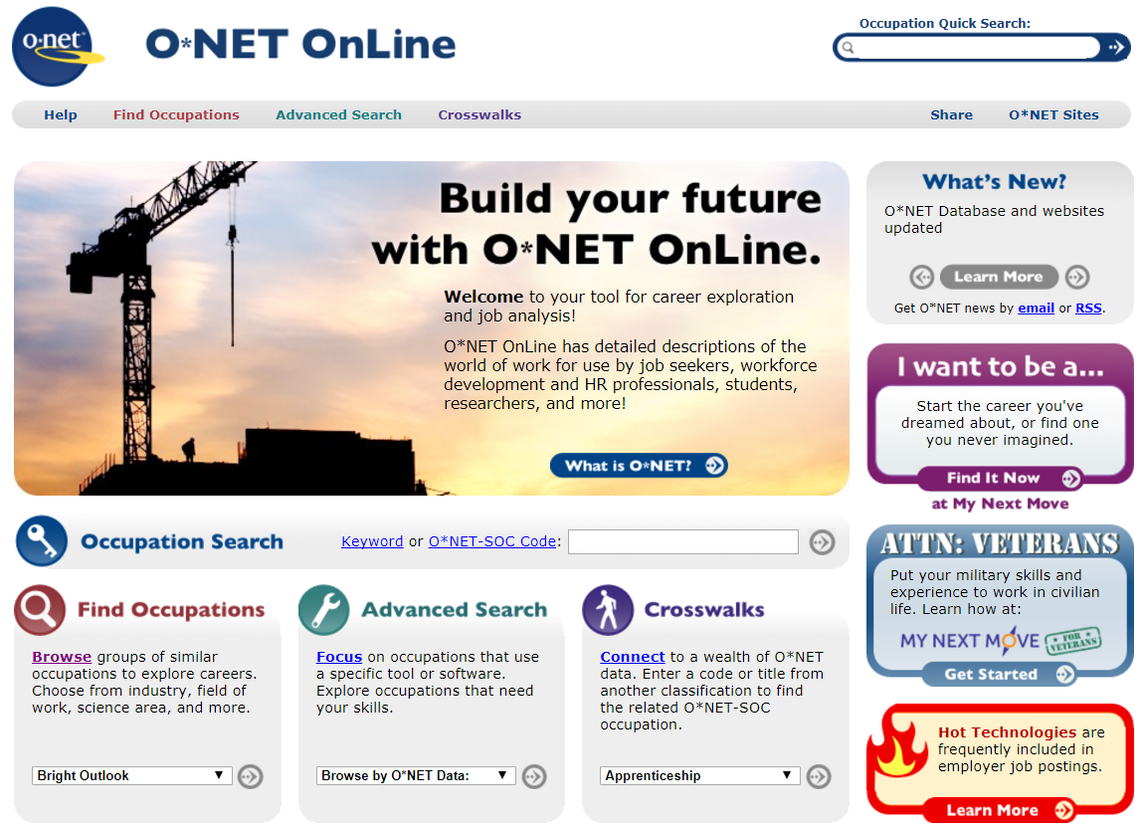

Slide 4
O*NET OnLine Find Occupations
Notes:
This is really just to show you that you can search O*NET OnLine in many different ways—depending on who you are and what you are doing
Primary method—and easily accessible from the front page is simply searching by keyword, title, (or even code if you know it in the search box IN THE UPPER RIGHT CORNER OF EVERY PAGE

Slide 5
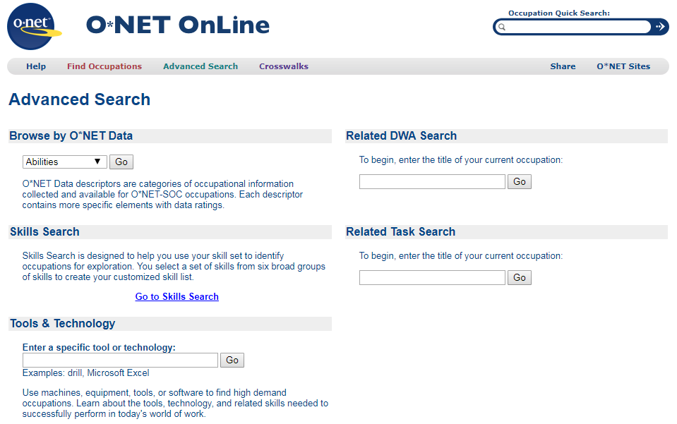
O*NET OnLine Advanced Search

Slide 6
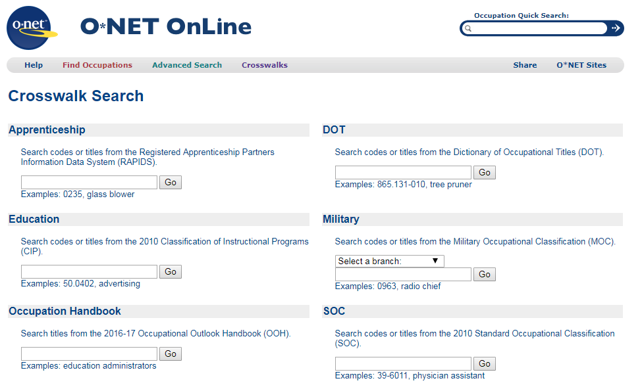
O*NET OnLine Crosswalk Search
Notes:
This is for people who are used to a certain classification system or coming from another product and want to find the related O*NET occupations
Apprenticeship
Education Classification of Instructional Program codes
OOH—which has 329 profiles (projections are for 819 SOC occupations) O*NET profiles for 974 occupation titles (but still not jobs)
DOT
Military
SOC—in case people don’t get it that the SOC code is embedded in the first six digits of the O*NET code and no crosswalk is needed

Slide 7
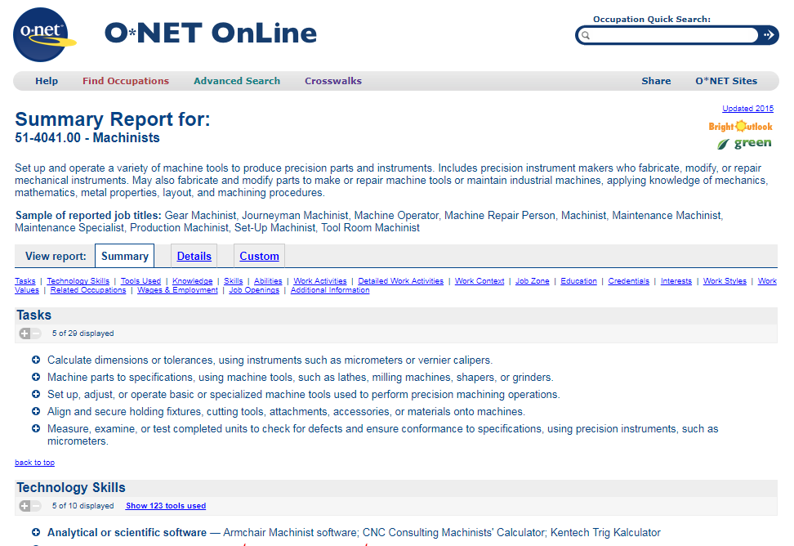
O*NET OnLine Summary Report

Slide 8
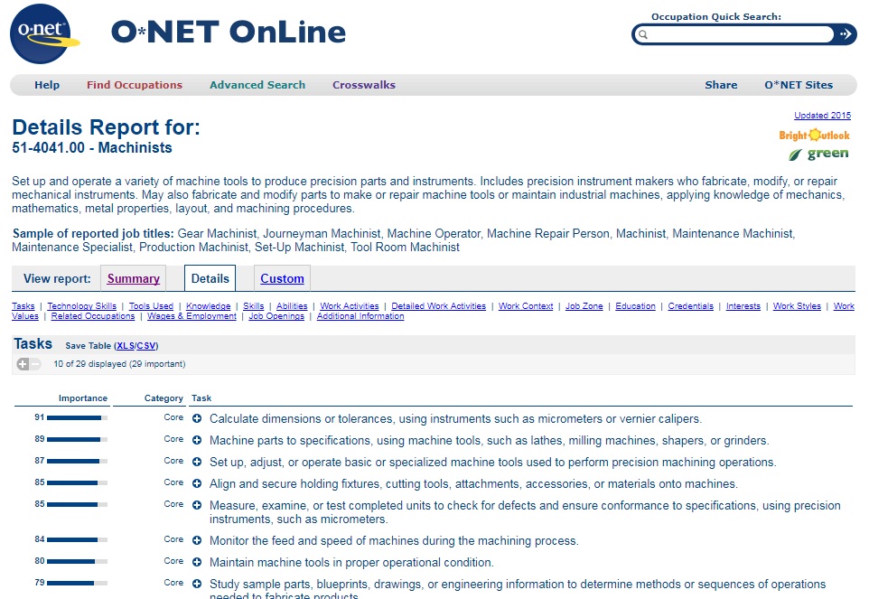
O*NET OnLine Details Report

Slide 10
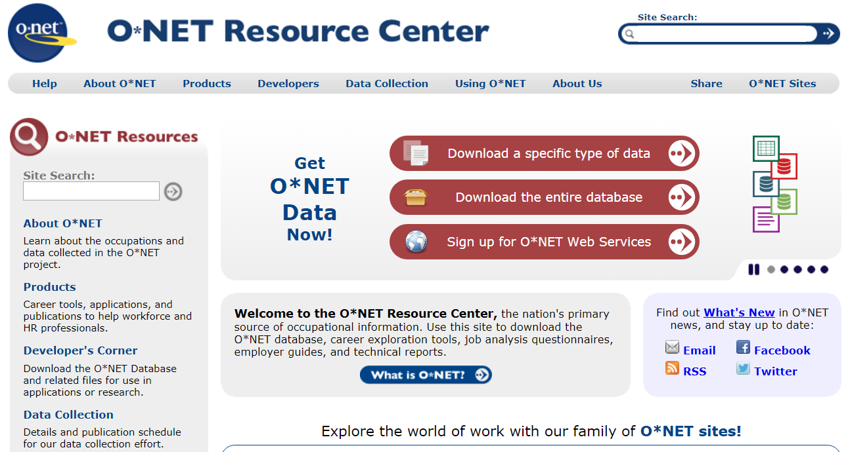
O*NET Data Downloads and Web Services
Notes:
What you see on the websites is just the tip of the iceberg—almost a showcase for what you can do
In the early days—developers could download the O*NET database and incorporate it into their own products
Now O*NET (and COS) offer web services and Application Programming Interfaces (APIs) and O*NET has over 1000 sign-ups for those services

Slide 13
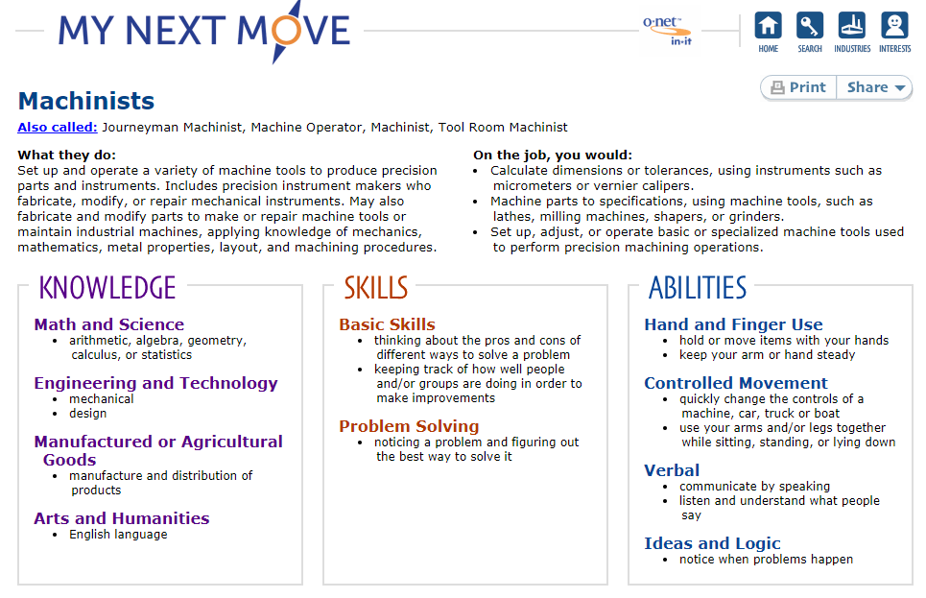

Slide 14
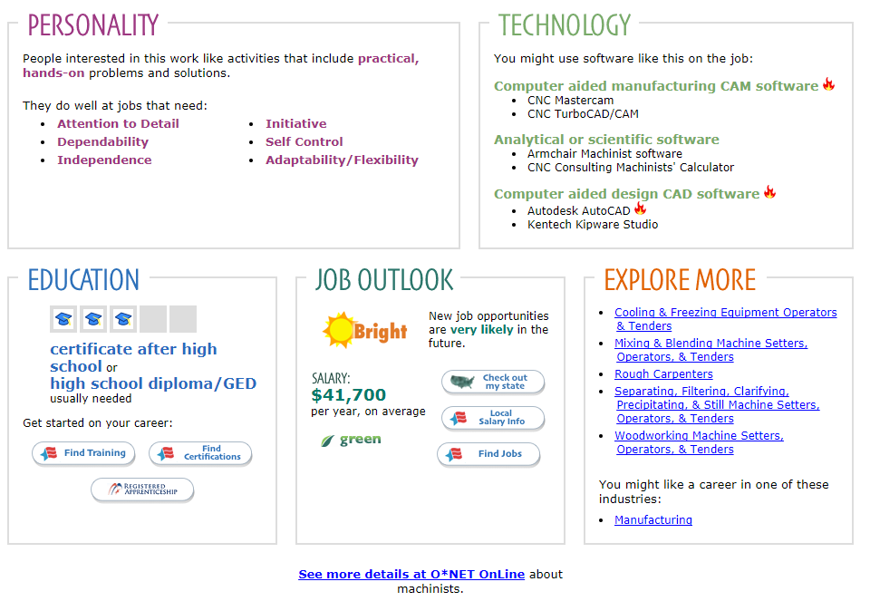

Slide 15
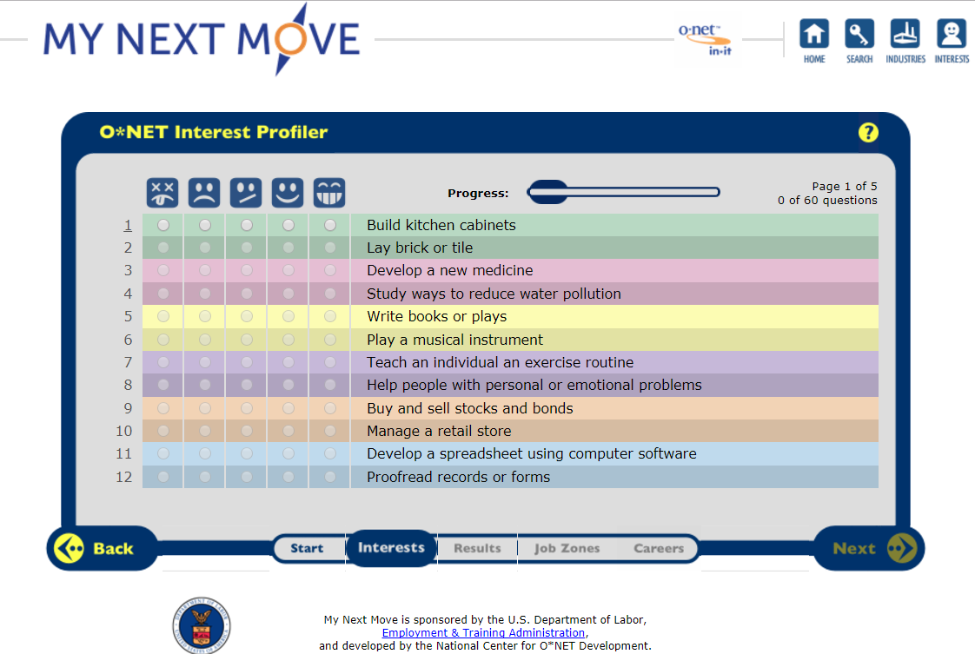
60 Question O*NET Interest Profiler

Slide 16
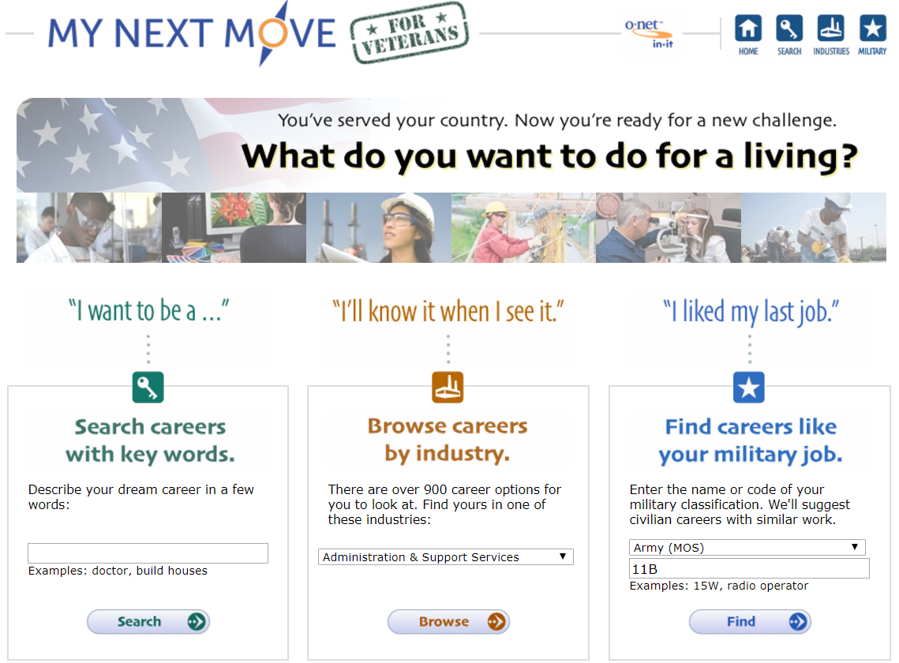

Slide 17
