Slide 1


A New Lens and
New Models
for the Nation
Gary Slutkin, MD
Founder and CEO, Cure Violence
Formerly World Health Organization
@Gslutkin / @CureViolence

Slide 2
A New Lens and
New Models
for the Nation
Gary Slutkin, MD
Founder and CEO, Cure Violence
Formerly World Health Organization
@Gslutkin / @CureViolence

Slide 3
Summary
1. Wrong course

Slide 4
Summary
1. Wrong course
2. Problems can be stuck

Slide 5
Summary
1. Wrong course
2. Problems can be stuck - wrong diagnosis

Slide 6
Summary
1. Wrong course
2. Problems can be stuck - wrong diagnosis
3. Re-understand our problems
4. Create new models

Slide 7
Summary
1. Wrong course
2. Problems can be stuck - wrong diagnosis
3. Re-understand our problems
4. Create new models
5. Change – can be immediate, sustained
6. Movement(s) required too

Slide 8
Reconsider what we “know” . . . what we do

Slide 9
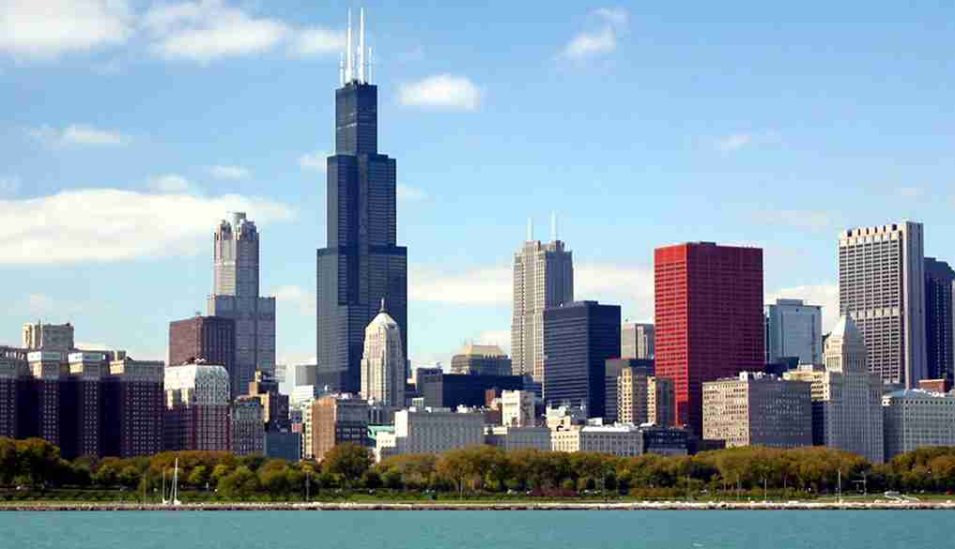
Notes:
U.S. city with skyscrapers

Slide 10
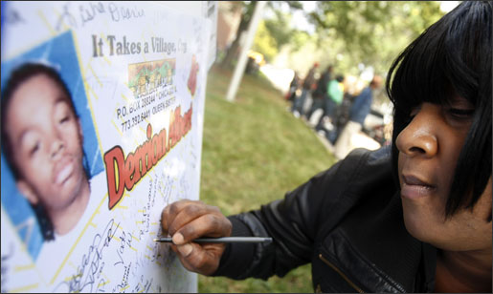

Notes:
This is a photo of a woman signing a poster that features a photo and the name (unreadable) of a young boy who had been shot or killed. The woman is frowning and focused on writing a message on the poster. In the background are other people milling about the area.

Slide 11
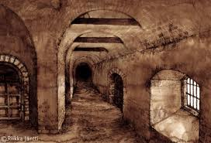
Notes:
This is a photo of an old, middle ages dungeon where with bars where they often used to put people with plague to isolate them and let them die. They did not isolate these people due to their contagion – instead, they were isolating them believing them to be morally corrupt people who they sent to the dungeons for punishment.

Slide 12
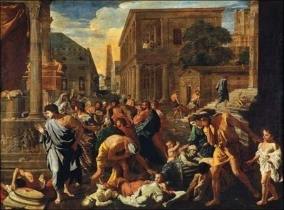
Notes:
This is a reproduction of a painting from the Middle Ages featuring a middle aged city, teeming with people, and people suffering and dying from the plague, a disease that was originally thought to be something that “morally unclean” people caught. As we know, science later proved that the plague had absolutely nothing to do with moralism and everything to do with bacteria and disease.

Slide 14
The everything theory
dysfunctional communities
poverty
poor schools
family disorders
absent fathers
broken homes
and more

Slide 15

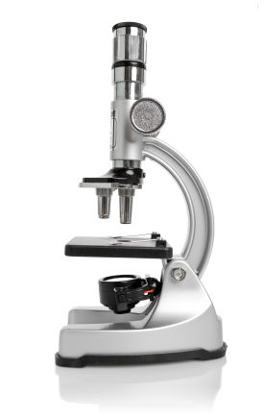
SCIENCE
Notes:
This is a photo of a microscope with a header of “Science” at the top of the slide.

Slide 16
SCIENTIFIC
APPROACH
Notes:
This is the same photo of a microscope with the header “Scientific Approach” at the top of the slide.

Slide 17
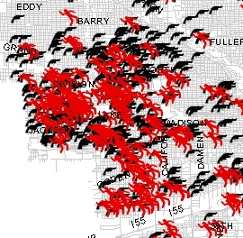
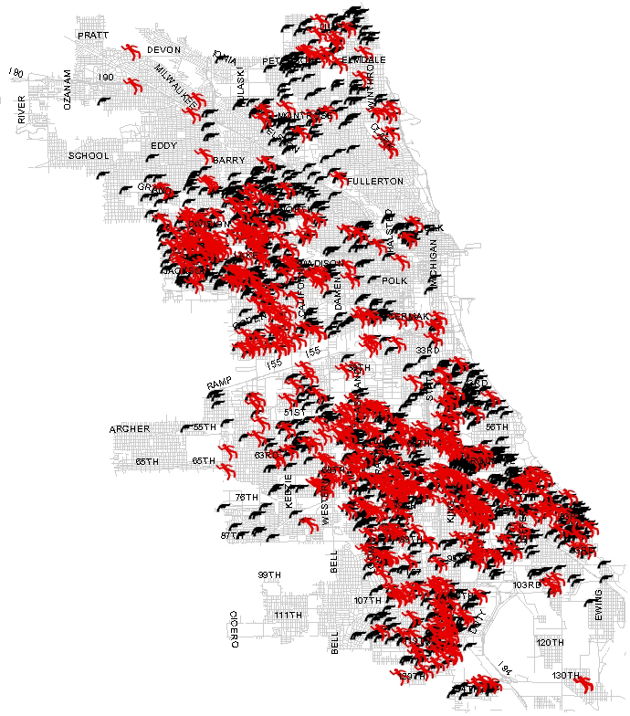
Violence
Notes:
This is a map of Chicago and Bangladesh, side by side. Both maps are colored with red clusters. In Chicago’s map, it’s clusters of violence, shootings and killings. In Bangladesh’s map, it’s clusters of cholera outbreak. The point of the slide is to show the clustering pattern in violence mimics that of cholera, a contagious disease.

Slide 18
EPIDEMIC WAVES (S) of VIOLENCE
(Killings in the U.S. )
1950
2000
Notes:
This is a graph that spans the timeframe from 1950 to 2000 and shows an increased line, almost double, with a few peaks and valleys from the 70s through the 90s showing the number of killings in the US. The number of killings in 2000 are almost double the number in 1950. The purpose of the slide is to illustrate the “waves” of violence that have occurred throughout the US over the last 60 years and the “wave” that follows much of the same epidemic patterns of contagious diseases.

Slide 19

Notes:
This is a stick figure of one person on this slide. It represents “Patient Zero” in the continuum of epidemiology.

Slide 20

Notes:
This is an illustration of that same Patient Zero stick figure, with an arrow pointed to the right and another stick figure just to the right of the arrow, indicating patient zero is transmitting to one additional person

Slide 21
New theory

Slide 22
Contagious

Slide 23
VIOLENCE
AS CONTAGIOUS
Disease
Clustering
Epidemic waves
Transmission

Slide 24
Contagious
(Dorland’s medical dictionary, 2011)
“capable of being transmitted”

Slide 25
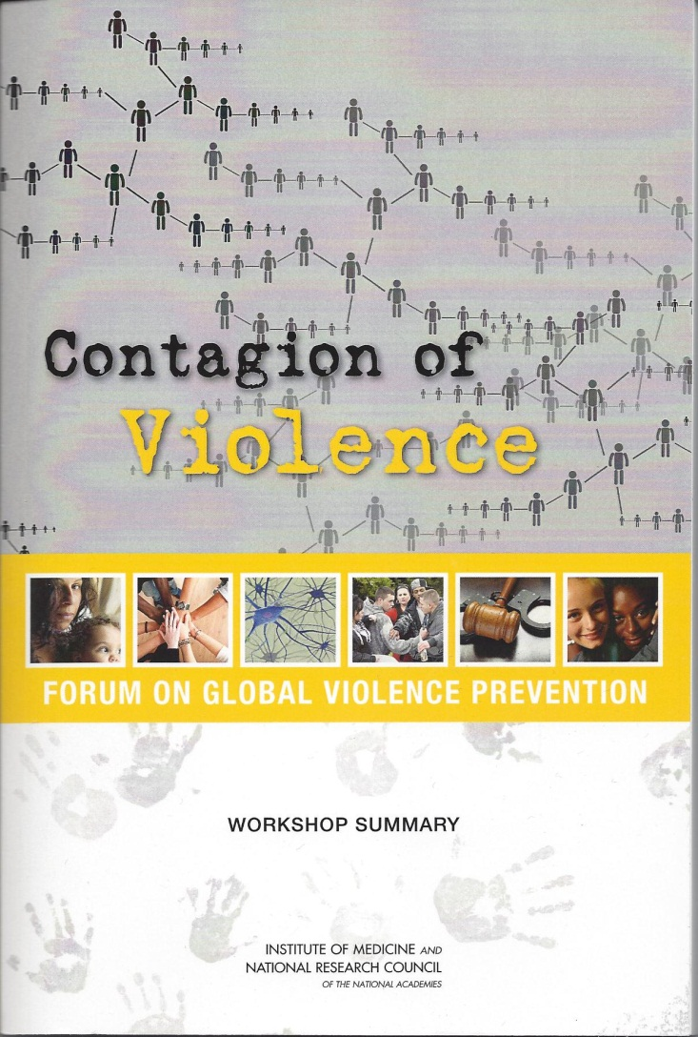
Notes:
This is the cover of a 2012 Institute of Medicine (National Academies) workshop, a forum on global violence prevention, which uses the same stick figures connected to show the spread of violence. Gary Slutkin has a chapter in this book and was a presenter/organizer of this workshop that focused on the contagious nature of violence.

Slide 26
New theory

Slide 27
New theory
Explains things

Slide 28
Contagion theory explains
Ups and downs
Perpetuation of child abuse
Violence increases after war ends
Suicide clusters
Copycat murders, mass shootings
Extremist recruitment

Slide 29
How is violence transmitted?

Slide 30
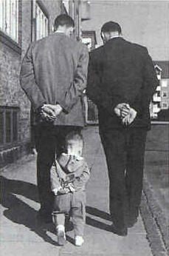
Notes:
This is a photo of the two men taken from the perspective of someone walking behind them. Both men are dressed in suits and both men have their heads down and their hands clasped behind their backs while they walk and talk. Following about 2 feet behind them is a little boy, about 3 years old, who is mimicking their walk, complete with his head down and his hands clasped behind his back. The focus of this slide is the brain’s copying of behavior we witness, our desire to “fit in” and be like everyone else.

Slide 31
BRIAN CIRCUITS FOR COPYING
From Jeannerod M in Gallagher S. Brainstorming 2008
Notes:
Schematic representation of how two people’s brain’s might interact with each other.
This slide is titled Brain Circuits for Copying and consists of a diagram based on two circles, one at the top of the slide and the other at the bottom of the slide. The circle at the top represents Agent A. The circle at the bottom represents Agent B. The beliefs, desires of Agent A lead to representation of self-generated action, Agent A then executes the action. Agent B receives the social signals from Agent A, continues the process of representing the observed action, estimates the social consequences and then reinforces the model by adopting those beliefs and desires to be Agent B’s own and the cycle continues back to Agent A, reinforcing the interaction between the two agents.

Slide 32
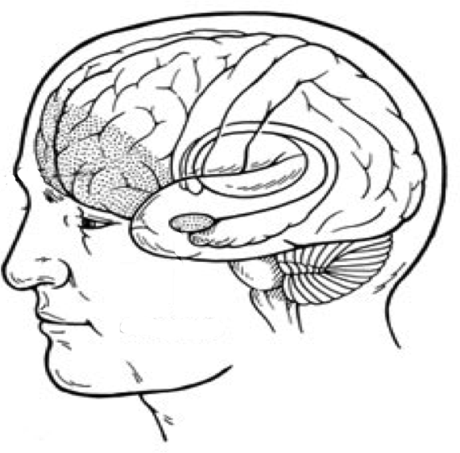
TRANSMISSION
Exposure
VIOLENCE
Observing
Witnessing
Notes:
This is a slide focused on the observation/witnessing of violence. There is a drawing of a male face with the brain highlighted in the drawing. The observation/witnessing focus on the brain is marked in the drawing, illustrating what part of the brain is affected by this behavior.

Slide 33
Transmission
Acquired
Modeled
Copied
Imitated

Slide 34
Transmission
Acquired
Modeled
Copied
Imitated
Very strong (and invisible) force

Slide 35
in pictures . . .

Slide 36
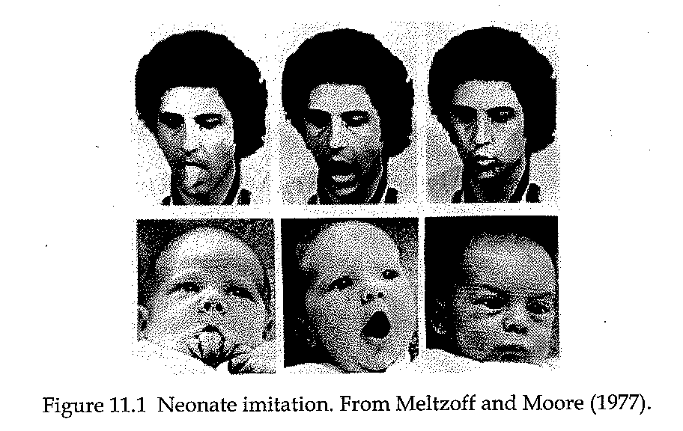
Notes:
This slide consists of two photos, one adult male with his tongue sticking out and the other a baby looking up with his tongue sticking out. The focus of the slide is on the copying, or mimicking behavior, even with babies. The brain is hardwired to want approval from others.

Slide 37
Notes:
This next slide ads the same two characters in alternate poses….this time the man is opening his mouth as if to yawn and the baby is opening his mouth as if to yawn.

Slide 38
Notes:
This slide adds a third set of photos using the same characters once again. In this photo the man is holding his breath and puffing out his cheeks. The baby is also holding his breath and puffing out his cheeks.

Slide 39
Copying
Notes:
This slide is a photo of a 4-5 year old boy wearing a toy police helmet and pointing a toy pistol at the photographer. The boy appears to have a belt with handcuffs like police wear as well. The boy is smiling.

Slide 40
Copying
Notes:
This slide is a photo of eight children, one of whom is pointing what appears to be a short-barrel machine gun and looking through its scope while the other kids around the child are holding up their two fingers in “V”s….the universal “peace” sign.

Slide 41
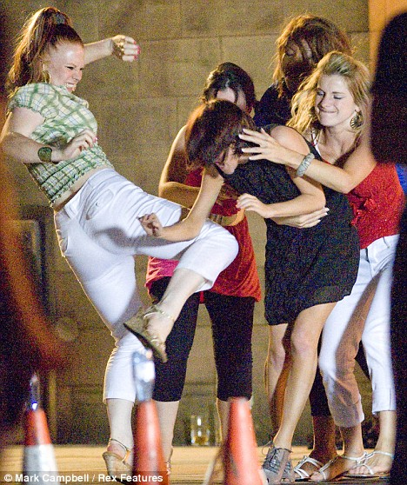
Notes:
This is a slide of four girls, all of whom are between the ages of 16 and 20 and who appear to be fighting. One girl has her right leg hitched up as if she is in the process of kicking the other girl and the girl who appears to be getting kicked is being held back from retaliating by one of the other girls. The girls look angry and mean.

Slide 42
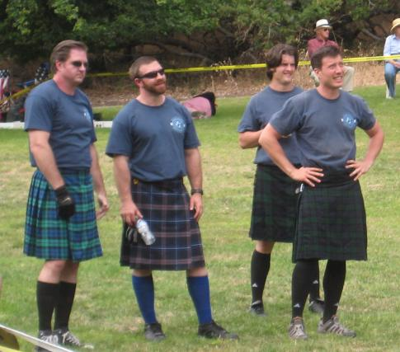
Notes:
This is a photo of four men, in their 20s and 30s, all wearing gray t-shirts and plaid kilts and dark knee high socks.

Slide 43
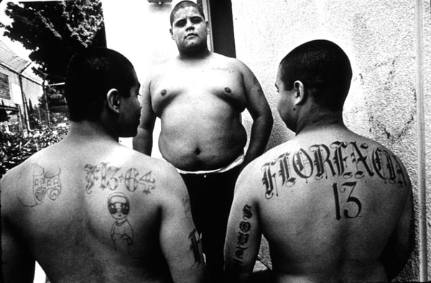
Notes:
This is a photo of three males with no shirts, one is facing the photographer and the other two have their backs to the photographer. The one facing the photographer appears to have no tatoos. The two with their backs to the photographer have multiple tatoos on their backs.

Slide 44
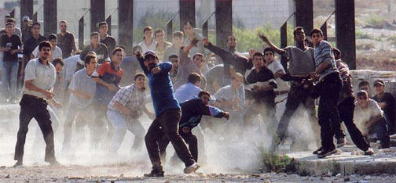
Notes:
This is a photo of a group of males who appear angry. All are standing or advancing in a dusty area strewn with rocks that appears to be the Middle East. Many are in the processing of hurling a rock, others are in the process of picking up rocks, some are watching to see where their rocks hit (somewhere behind the photographer). The photo is focused on “mob action.”

Slide 45
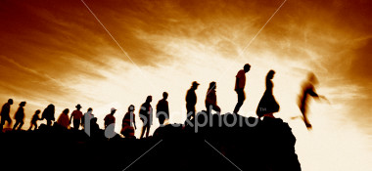
The Result
Image: istockphoto.com
Notes:
This is a photo of a group of silhouetted people, about 20 in number, who are lined up, single file on a clifftop. One silhouetted person has just jumped from the cliff and the others appear poised to follow/copy the behavior they have just witnessed.

Slide 46
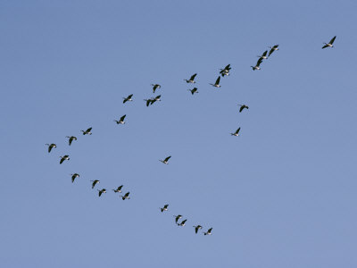
Notes:
This is a photo of birds flying in a V formation south for the winter.

Slide 47
TRANSMISSION
Exposure
VIOLENCE
Observing
Vicitimized
Notes:
This is a slide focused on the observation/witnessing of violence. There is a drawing of a male face with the brain highlighted in the drawing. The observation/witnessing focus on the brain is marked in the drawing, illustrating what part of the brain is affected by this behavior.

Slide 48
TRANSMISSION
Pain centers
Cortical
VIOLENCE
Observing
Victimized
Dopamine
BRAIN PROCESSING
Notes:
This is the same slide with the same drawing as the one prior, but the addition of pain centers highlighted in the brain. The two main pain centers of the brain are the cortical and the dopamine.

Slide 49
TRANSMISSION
Pain centers
Cortical
VIOLENCE
Observing
Vicitimized
Trauma
Dopamine
Limbic
BRAIN PROCESSING
Notes:
Again, this is the same slide as the previous two with the addition of the limbic center of the brain identified as to link with witnessing trauma.

Slide 50
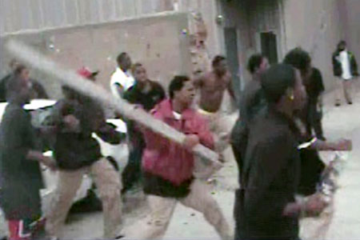
Notes:
This is a photo that appears to have been taken in the Middle East of a group of men who are gathered in a heavily damaged section of a city. The dominant person in the photograph is a man in a red jacket who appears to be swinging a long 2x4 and the group of males seems poised to attack someone or something off camera.

Slide 51
Trauma
Acceleration

Slide 52
Trauma
Acceleration
hypervigilance
hyperarousal
other

Slide 53
Trauma
Acceleration
Other awful health effects

Slide 54
Exposure to violence - effects on health :
-
Heart disease | Lung disease
Stroke | Hepatitis
Cancer | Asthma
Diabetes

Slide 55
Exposure to violence effects on health :
-
Heart disease | Lung disease
Stroke | Hepatitis
Cancer | Asthma
Diabetes | Violence

Slide 56

TRANSMISSION
OF VIOLENCE
Exposure to
Violence
Violence
Source: Mullins et al. 2004; Devries et al. 2011
Notes:
This slide contains a graph. Along the x access is violence; along the y access is Exposure to violence. Contrary to most graphs with the exposure to violence increasing as one moves up the y access, this exposure measure to violence has an arrow pointed down the y access. No violence, no exposure to violence is at the 0,0 coordinates of the graph. The graph shows a shaded gray arc that stretches from the top of the y access to the right edge of the x access. A dotted red straight line with an arrow at the end bisects the gray shading at about a 45% angle.

Slide 57

MULTIPLE EXPOSURES
Exposures
COMMUNITY
Outcomes
MULTIPLE EVENTS
Notes:
This slide shows an entire community of stick figures surrounded by arrows. At the top of the slide in blue is the phrase “Multiple Exposures” and at the bottom of the slide in blue is the phrase “Multiple Events”. The arrows surround the community of stick figures in two/three rings and reinforce the notion that multiple exposures lead to multiple events. More exposure means more violence.

Slide 58
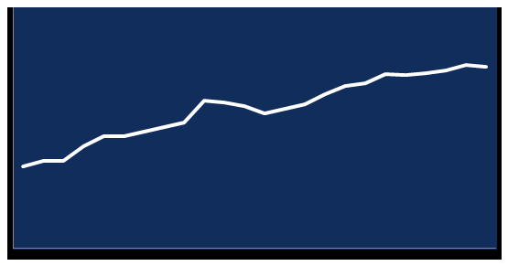
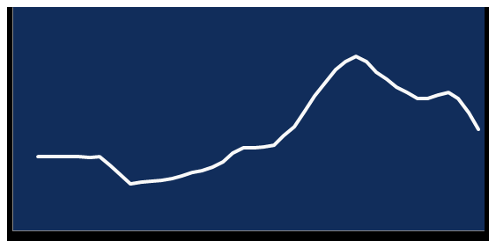
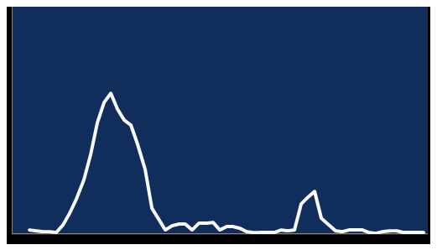
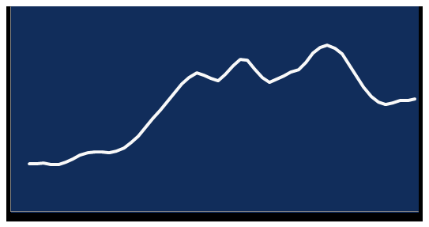
KILLING EPIDEMICS
VIOLENCE BEHAVES EXACTLY LIKE A CONTAGIOUS DISEASE
Country A
Country C
1950
2008
1960
2003
Country B
Country Billings in Rwanda
Country D
4/1994
5/1994
1980
2003
Notes:
This slide shows four graphs for four different countries, A, B, C and D. In each country but Country B, the epidemics continue to gain traction in waves over time. In Country B, there are two mountainous peaks of epidemics, but the epidemics flatline and do not increase in Country B.

Slide 59
Notes:
This is the cover of a 2012 Institute of Medicine (National Academies) workshop, a forum on global violence prevention, which uses the same stick figures connected to show the spread of violence. Gary Slutkin has a chapter in this book and was a presenter/organizer of this workshop that focused on the contagious nature of violence.

Slide 60
Transmission across syndromes community family spousal child suicide war

Slide 61

HOW TO
STOP
EPIDEMICS
Notes:
The World Health Organization logo is at the bottom of this slide.

Slide 62

How to Stop Epidemics
1. Interrupt transmission
Prevent future spread
3. Change group norms

Slide 63
Notes:
This is a stick figure of one person on this slide. It represents “Patient Zero” in the continuum of epidemiology.

Slide 64
Notes:
This is an illustration of that same Patient Zero stick figure, with an arrow pointed to the right and another stick figure just to the right of the arrow, indicating patient zero is transmitting to one additional person.

Slide 65
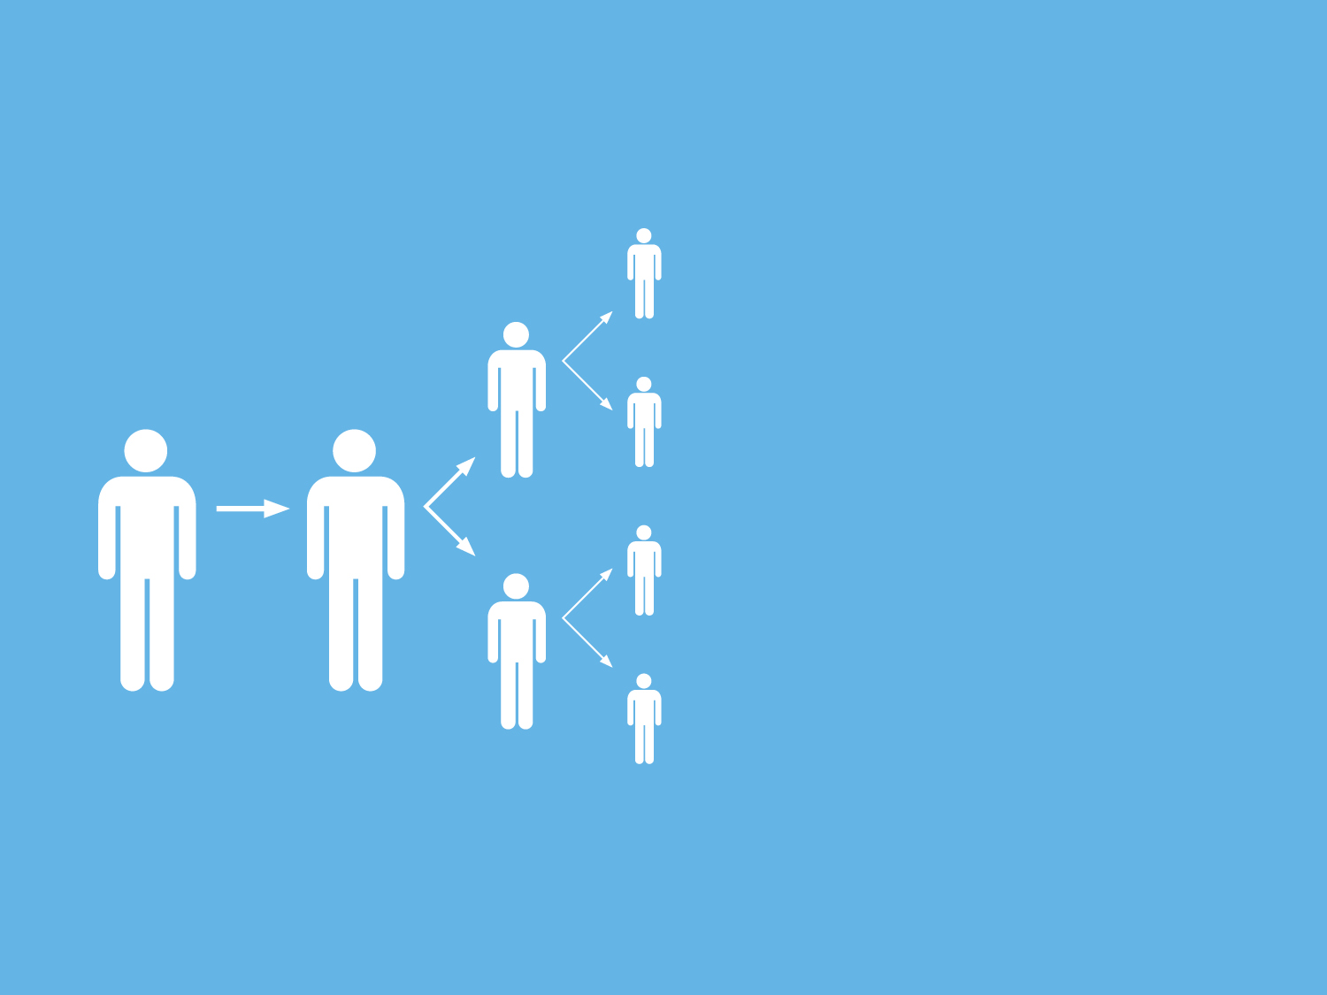
Notes:
This slide is the same slide as #75 with the stick figures. It shows a total of eight stick figures, starting with the one stick figure with the arrow to the second, followed by an additional two arrows that lead to two stick figures, followed by an additional four arrows that lead to four additional stick figures.

Slide 66
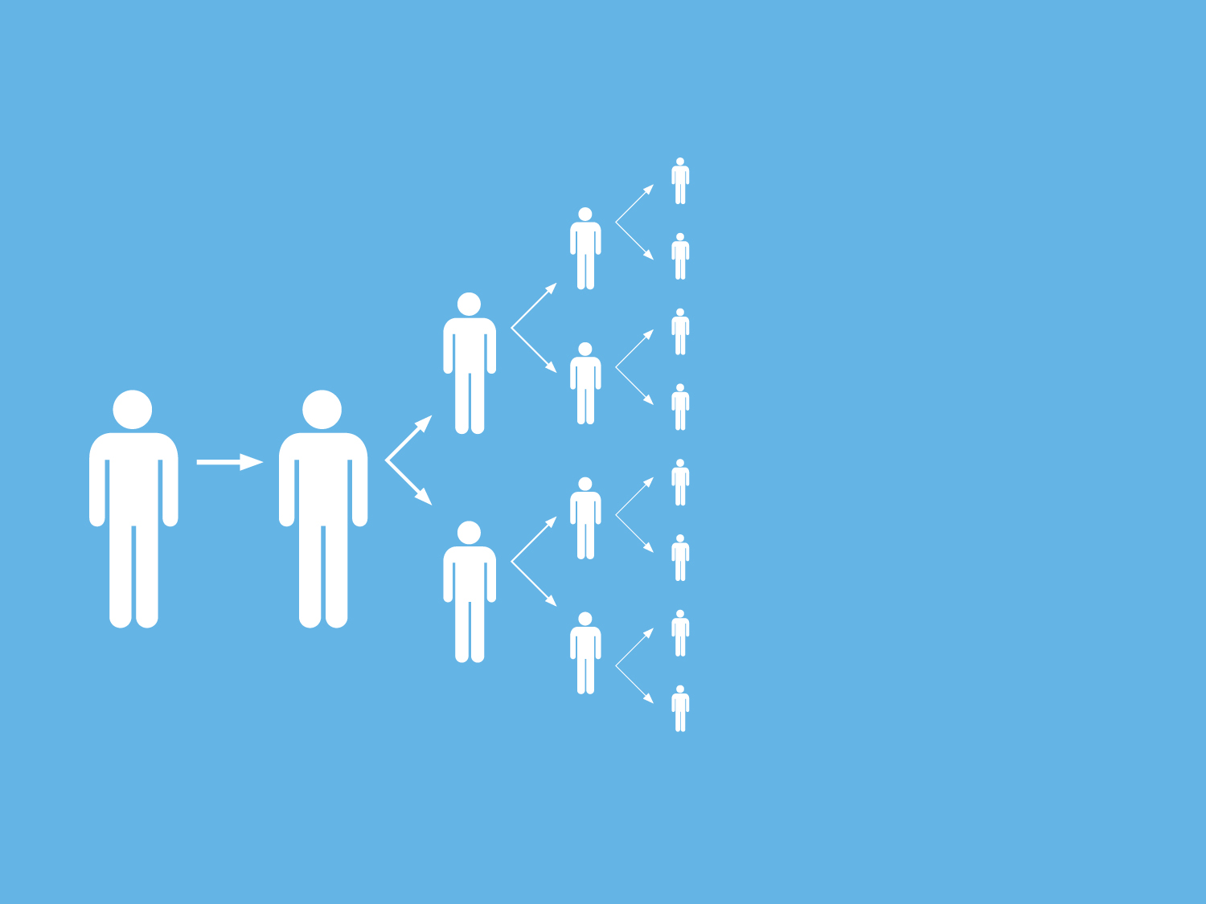
Notes:
This slide builds on the previous slides and adds four more sets of arrows from the four stick figures and then adds a total of eight additional stick figures.

Slide 67
New categories of workers

Slide 68
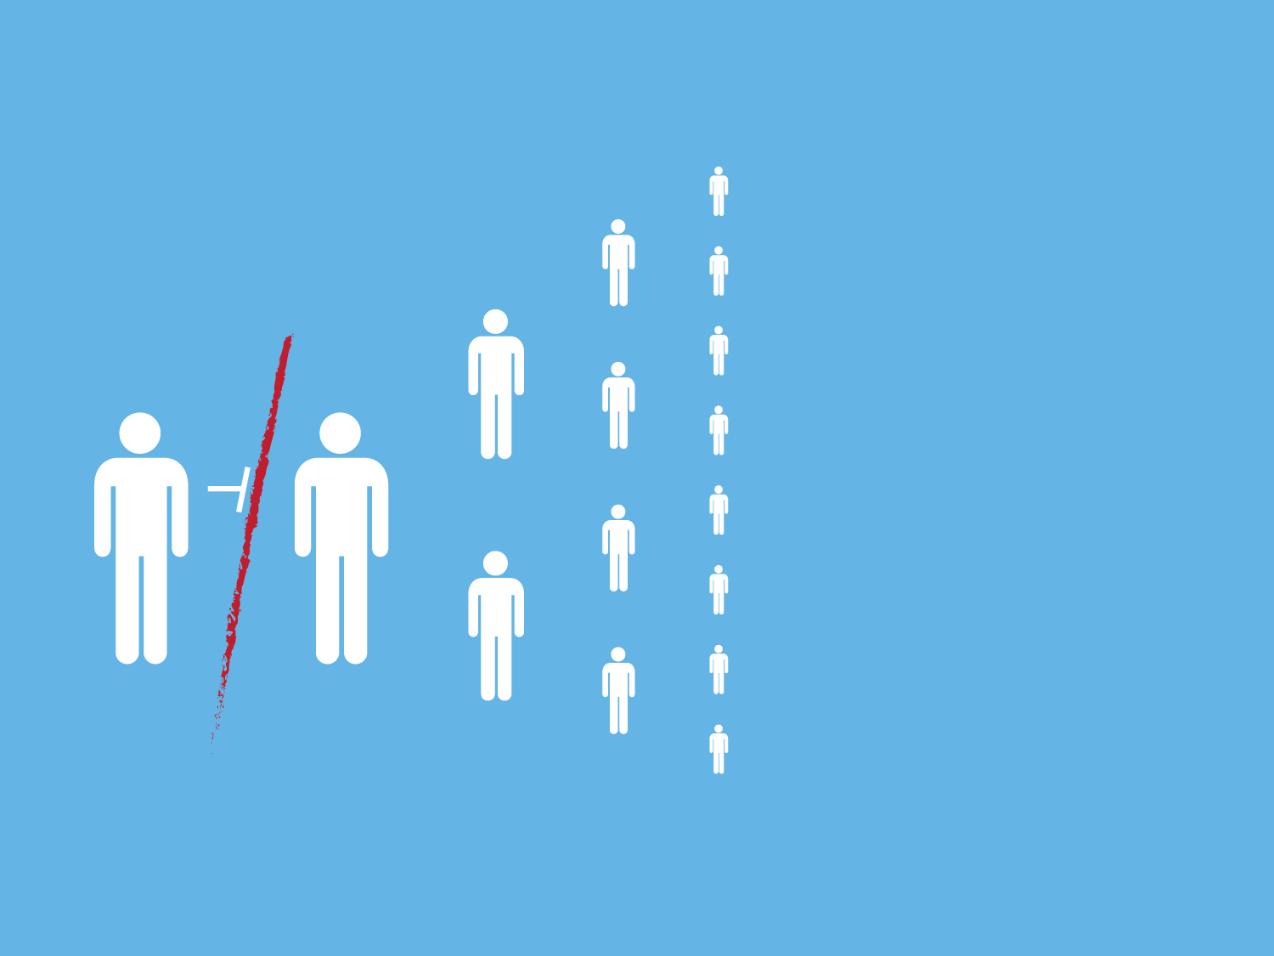
Notes:
This slide is the same slide as the previous slide with a bright red vertical slash through the first arrow between stick figure one on the left and stick figure two. The remainder of the arrows on the diagram are eliminated and the stick figures are suspended on the slide with no connections to one another.

Slide 69
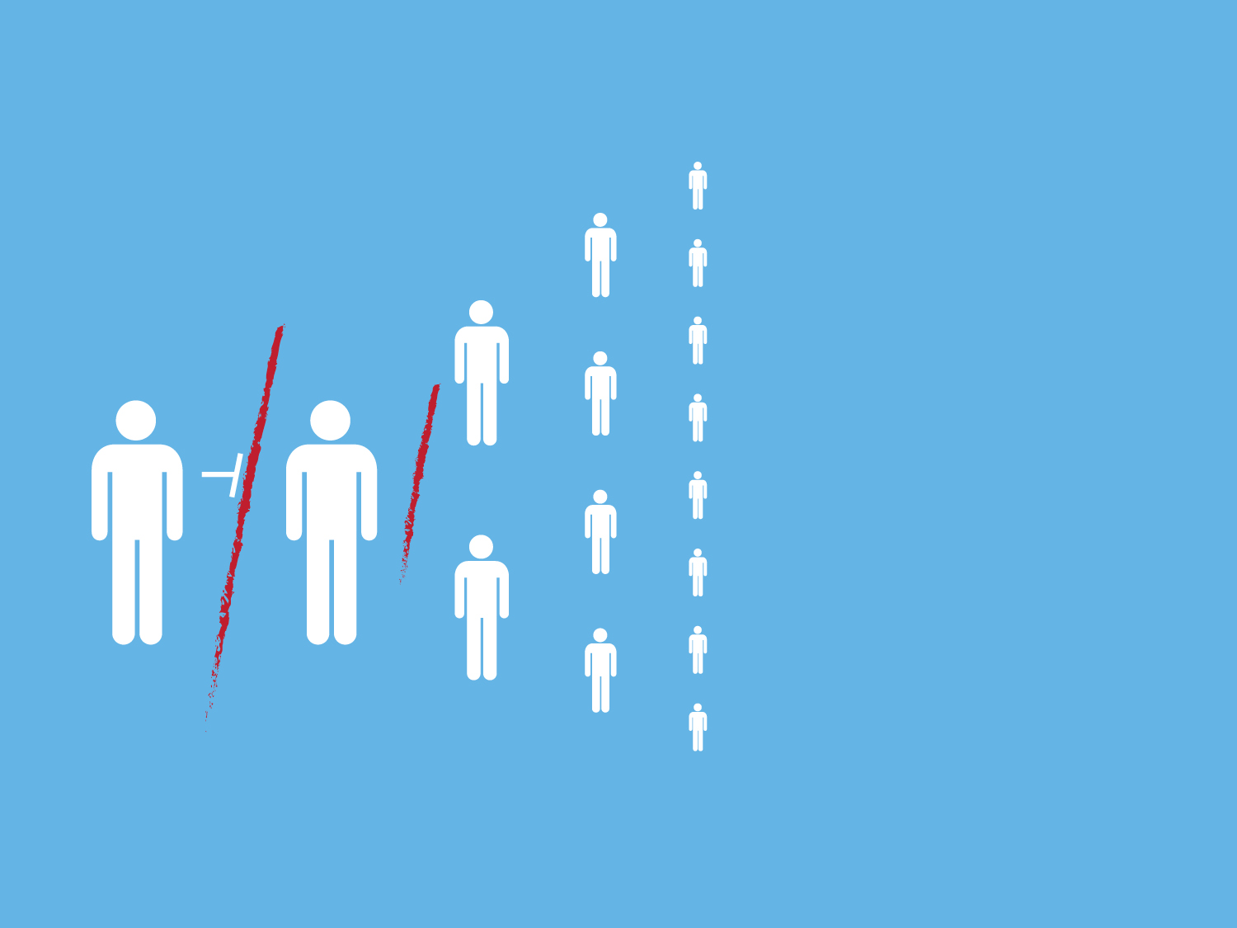
Notes:
This slide is the same slide as the previous slide with a bright red vertical slash through the first arrow between stick figure one on the left and stick figure two. The remainder of the arrows on the diagram are eliminated and the stick figures are suspended on the slide with no connections to one another. An additional bright red slash to the right of the second stick figure has been added to this slide.

Slide 70

Notes:
This slide is the same slide as the previous slide with a bright red vertical slash through the first arrow between stick figure one on the left and stick figure two. The remainder of the arrows on the diagram are eliminated and the stick figures are suspended on the slide with no connections to one another. An additional bright red slash to the right of the second stick figure has been added to this slide. Two additional bright red vertical slashes have been added to the right of the two stick figures, illustrating the concept that the contagion has been stopped.

Slide 71
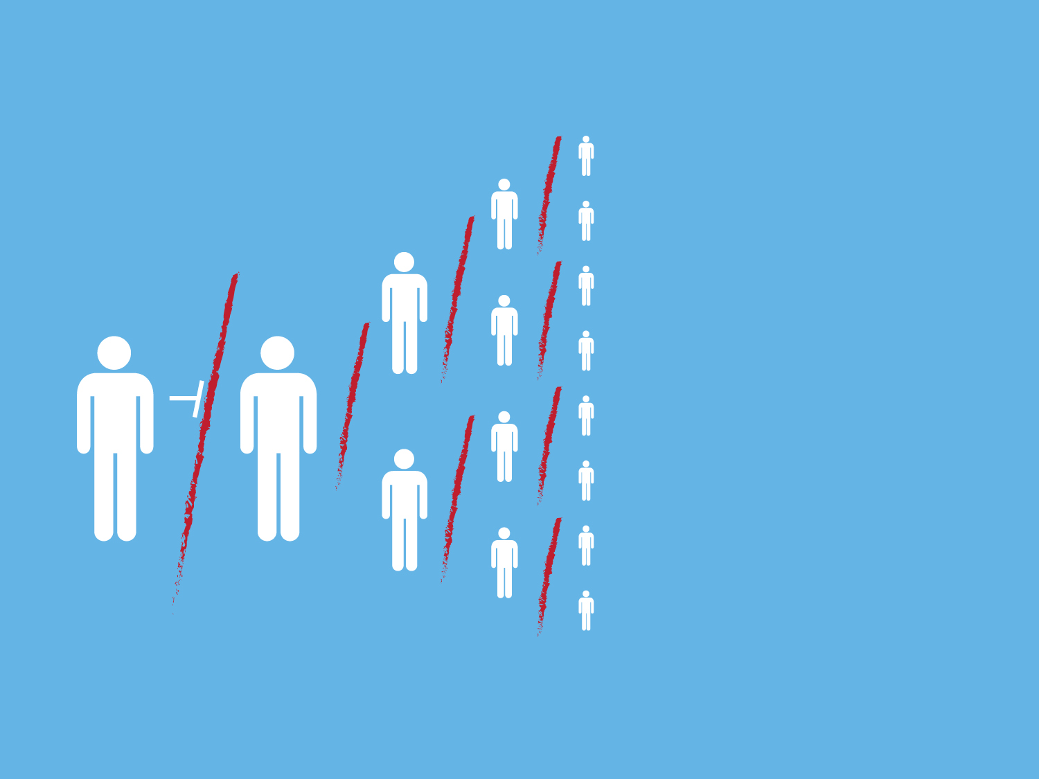
Notes:
This slide is the same slide as the previous slide with a bright red vertical slash through the first arrow between stick figure one on the left and stick figure two. The remainder of the arrows on the diagram are eliminated and the stick figures are suspended on the slide with no connections to one another. An additional bright red slash to the right of the second stick figure has been added to this slide. Two additional bright red vertical slashes have been added to the right of the two stick figures, illustrating the concept that the contagion has been stopped. Four additional bright red vertical slashes have been added to this slide.

Slide 72
NEW NORMS
Notes:
This slide is the same slide as the previous slide with a bright red vertical slash through the first arrow between stick figure one on the left and stick figure two. The remainder of the arrows on the diagram are eliminated and the stick figures are suspended on the slide with no connections to one another. An additional bright red slash to the right of the second stick figure has been added to this slide. Two additional bright red vertical slashes have been added to the right of the two stick figures, illustrating the concept that the contagion has been stopped.
This slide adds the word “New Norms” to the right of the vertical line of eight stick people, indicating that once the contagion has been stopped, new norms can occur.

Slide 73
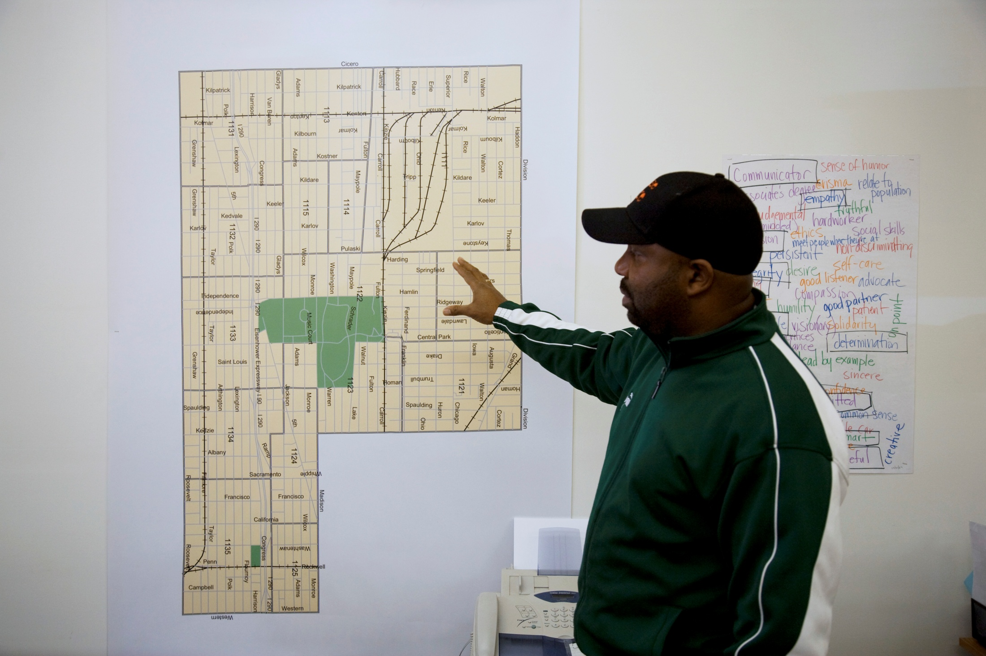
Mapping
Notes:
This slide is a photo of a male standing in front of a map that appears to be a police district or neighborhood map. The man has his hand raised towards the map as if he is teaching or sharing an idea with an audience that is unseen in the photograph. There is a black silhouette of an urban scape at the bottom of the photo with the word “Mapping” against the silhouette urban scape.

Slide 74
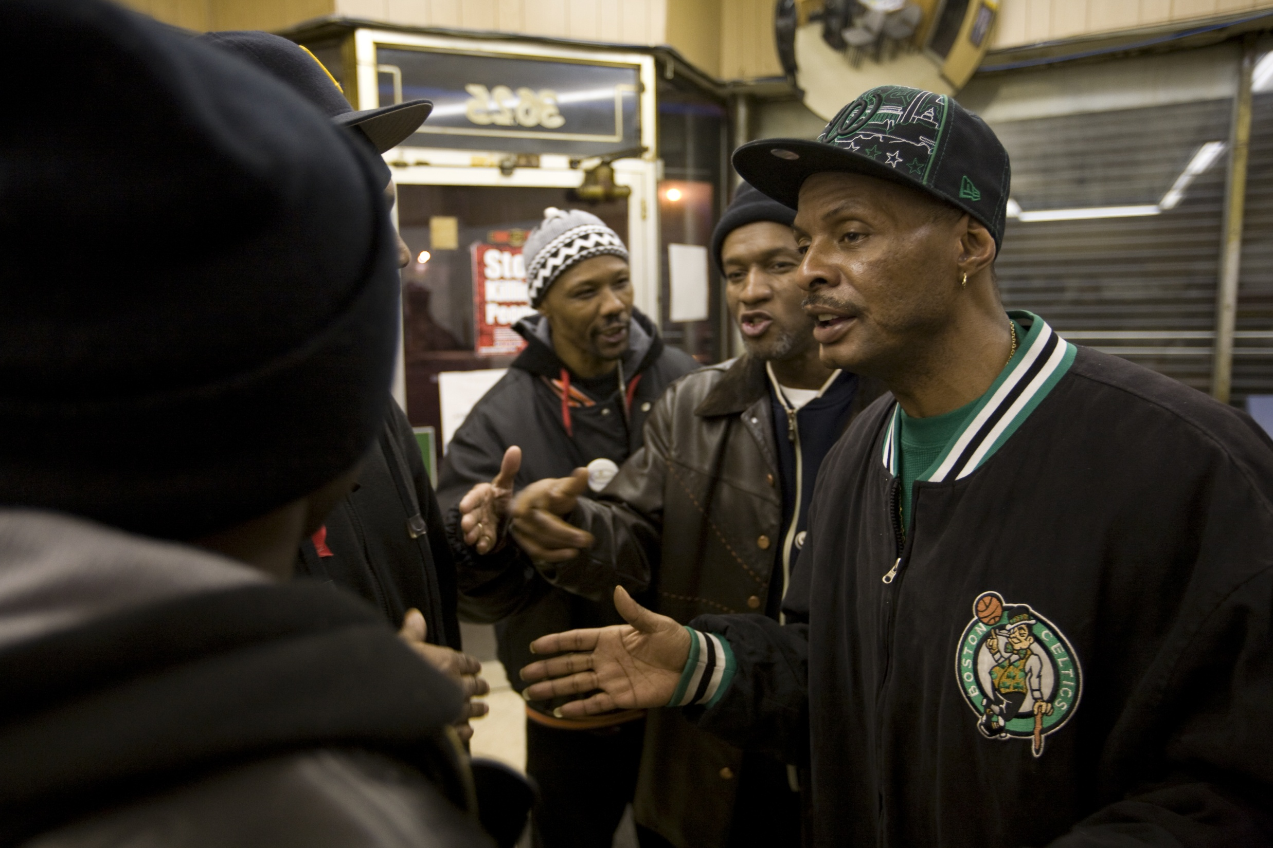
Violence interrupters
Photograph by Ed Kashi
Notes:
This slide is a photograph of three men facing the camera. It is taken in some sort of office and the men are dressed as if they’ve come in from the cold. They have their hands out in front of them gesturing at two people who are only seen in profile on the left side of the photo. It’s as if they are talking or trying to persuade the two profiled of something. The word “violence interrupters” is at the bottom of the photo.

Slide 75
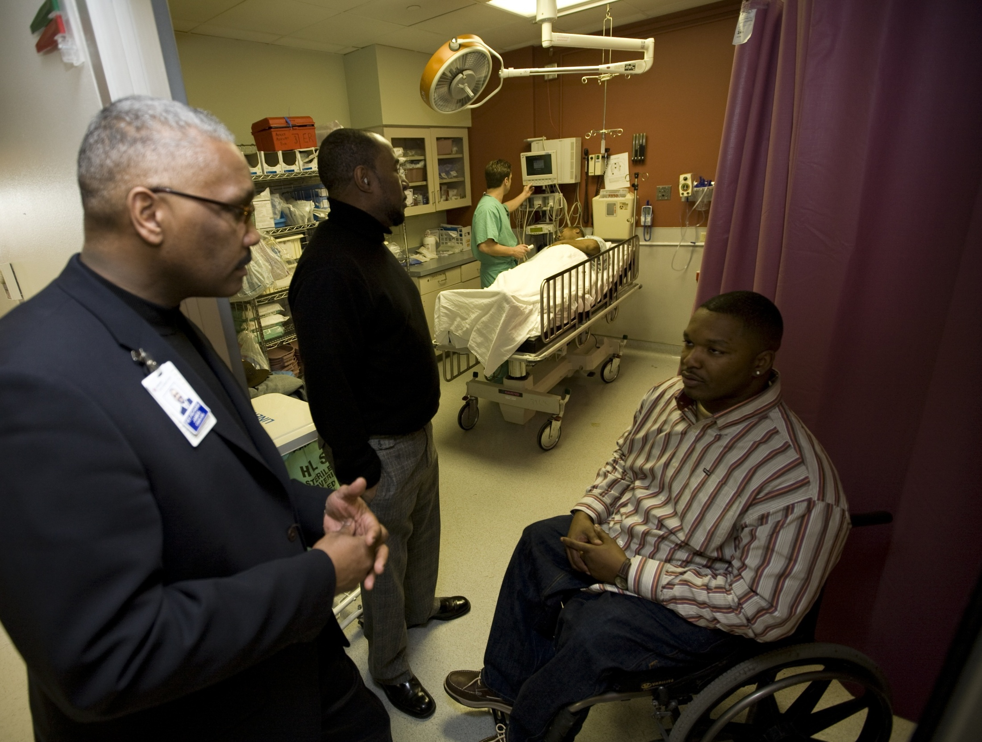
Hospital responders
Notes:
This slide shows the inside of an emergency room. A doctor in scrubs is in the background tending to a patient who is unidentifiable on a transport hospital cart. There are three men in the foreground of the photo, one in a wheelchair, fully dressed, another who appears to be a member of clergy standing facing the man in the wheelchair talking to him and another male who appears to be staff member at the hospital who is turned sideways and looking at something the camera doesn’t identify.

Slide 76
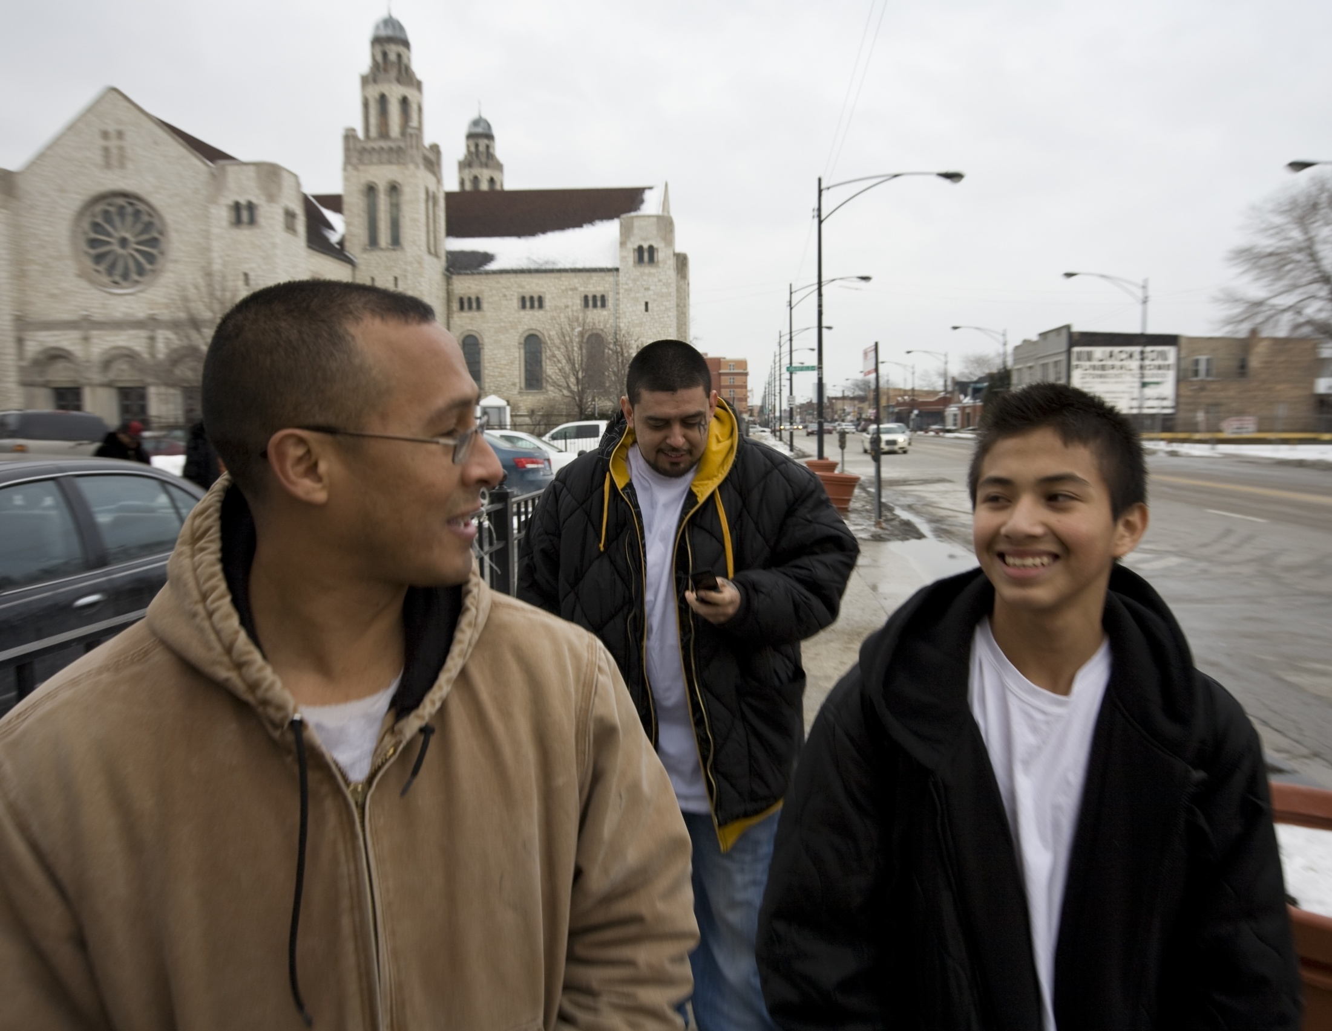
Behavioral outreach workers
Photograph by Ed Kashi
Notes:
This photo shows an urban setting with a large catholic church in the background. Three young men are walking towards the photographer who is taking the photo. Two are in the foreground and the older of the two is talking to the younger one. There is a man behind them both facing the photographer but looking down at his cell phone in the picture. A street in the background. The photo was taken outdoors in the winter.

Slide 77
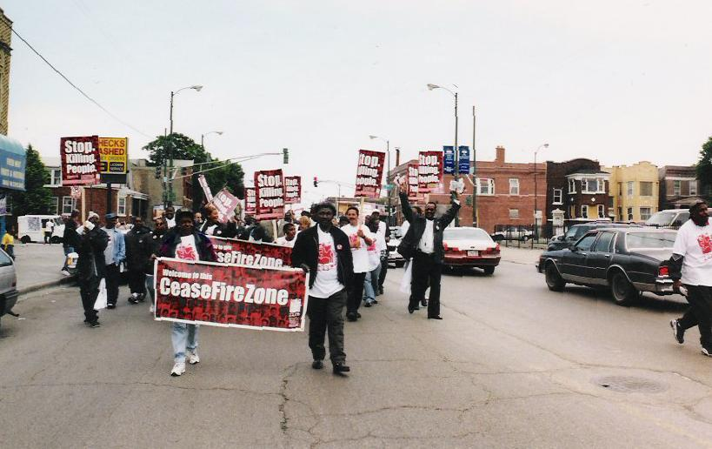
Community outreach
Photograph by Ed Kashi
Notes:
This slilde shows a photo of a group of people carrying a Cure Violence banner and posters on sticks that say “Stop Killing People.” They are marching towards the photographer and are engaged in a protest march on a street in an urban area. There are approximately 25 people visible in the photo.

Slide 78
Health - Community
System

Slide 79
RESULTS

Slide 80

67%
shootings

Slide 81
Results – Logan Square Cure Violence
CURE VIOLENCE
Notes:
This photo contains a graph that covers the entire slide. On the Y access are single digit numbers representing the number of killings in the Logan Square neighborhood of Chicago. On the X access, the timeline runs from January 1999 through September 2012. The graph marks the beginning of the Cure Violence program in this area in January 2003 and shows that the killings drop rapidly once the Cure Violence program is started.

Slide 82
Health approach
“Immediate”
Skogan, DOJ Evaluation Report, 2008

Slide 83
Results – Logan Square Cure Violence
CURE VIOLENCE
Notes:
This photo contains a graph that covers the entire slide. On the Y access are single digit numbers representing the number of killings in the Logan Square neighborhood of Chicago. On the X access, the timeline runs from January 1999 through September 2012. The graph marks the beginning of the Cure Violence program in this area in January 2003 and shows that the killings drop rapidly once the Cure Violence program is started. It is a repeat of Slide #97. To note that the killings stay low following the start of the Cure Violence program in 2003 and that the drop in killings was large and even eliminated in early 2007, 2008, late 2010/early 2011 and in 2012.

Slide 84

DOJ - EXTERNAL EVALUATION
↓ 41 – 73% shootings and killings (overall effect seen)
↓ 16 - 28% shootings and killings (directly attributable)
↓ 15 - 40% shooting density
↓ 100% retaliation murders in 5 of 8 communities
85-97% helped to jobs, school, out of gang
DEMONSTRATED EFFECTIVE
TO REDUCE SHOOTINGS AND KILLINGS
Skogan, 2009
Notes:
This slide focuses on the results of the DOJ external evaluation and contains the Seal of the US Department of Justice as artwork on the slide.

Slide 85
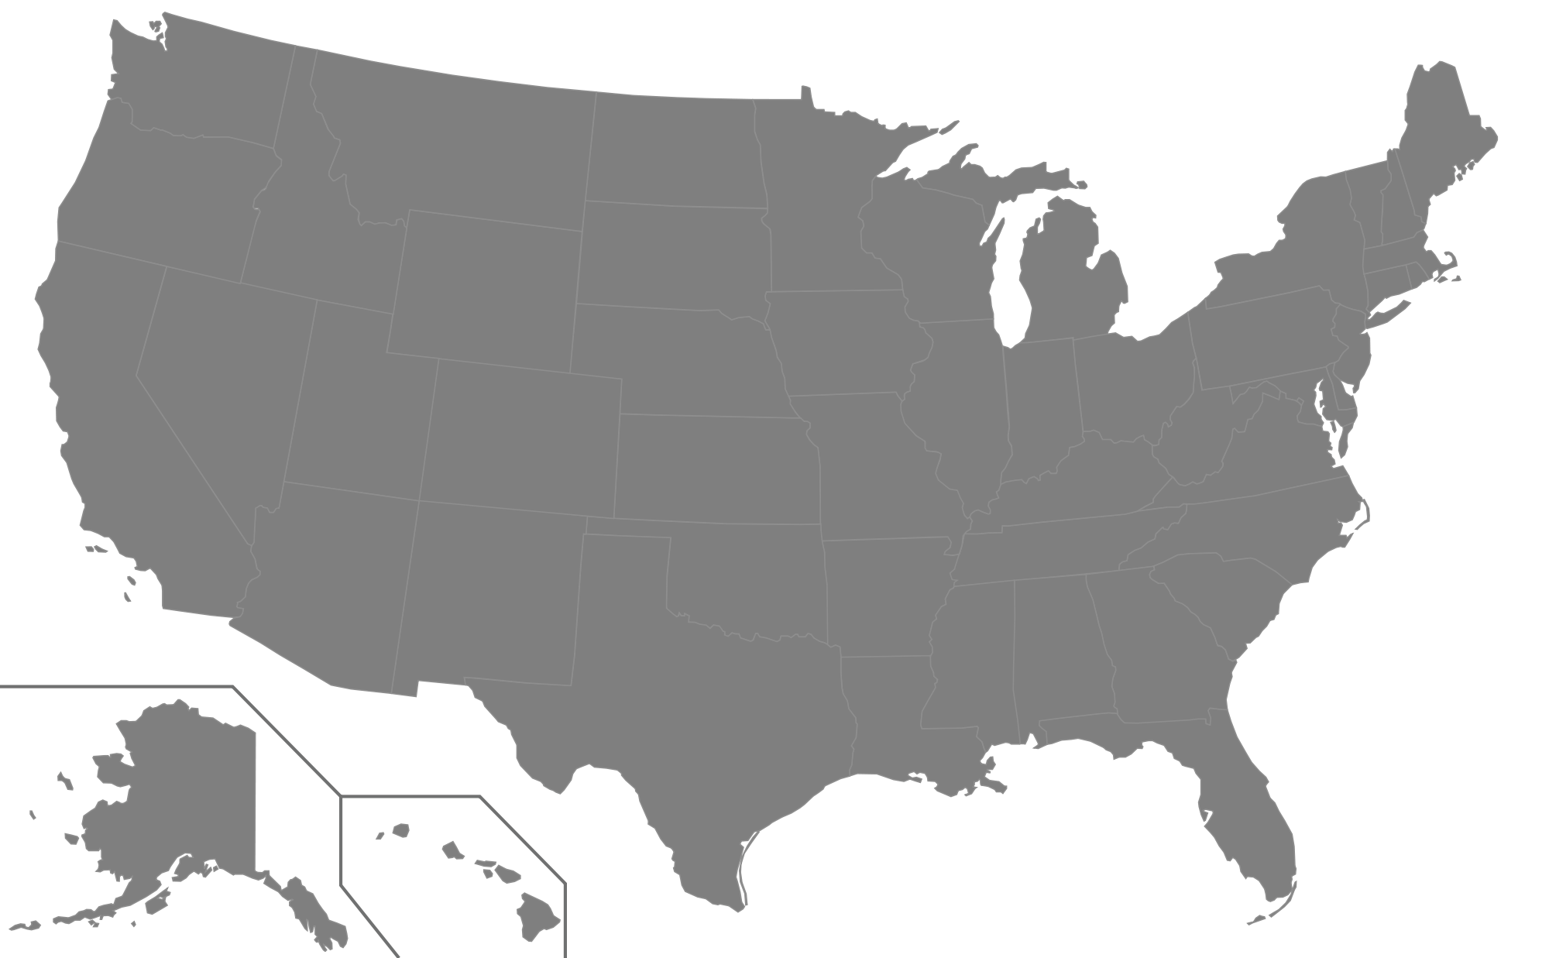
HEALTH APPROACH May 2015
(incomplete)
SEATTLE
TROY
MINNEAPOLIS
SYRACUSE
BOSTON
MILWAUKEE
ROCHESTER
ALBANY
NORTH CHICAGO
BUFFALO
MT VERNON
MAYWOOD
YONKERS
CHICAGO
NEW YORK CITY
HEMPSTEAD
SAN FRANCISCO
ROCKFORD
CICERO
PHILADELPHIA
CAMDEN
RICHMOND
SPRINGFIELD
BALTIMORE
WILMINGTON
OAKLAND
KANSAS CITY
EAST ST. LOUIS
LOS ANGELES
ST. LOUIS
SAN ANTONIO
NEW ORLEANS
MIAMI
HEALTH APPROACH
Loiza, PR
Notes:
This slide contains the same grayscale map of the US. Cities who are using a health approach to violence prevention are marked with yellow dots and include: LA, Oakland, San Francisco, Richmond, Seattle, Kansas City, St. Louis, East St. Louis, New Orleans, San Antonio, Loiza, Puerto Rico, Ami, Minneapolis, Milwaukee, North Chicago, Maywood, Rockford, Springfield, Chicago, Syracuse, Rochester, Buffalo, Yonkers, NYC, Philadelphia, Baltimore, Camden, Wilmington, Hempstead, Mt. Vernon, Albany, Troy and Boston.

Slide 86

Cure Violence international adaptations
Apr 2015
CANADA
ENGLAND
UNITED STATES
ISRAEL/
WEST BANK
SYRIA
EGYPT
IRAQ
MEXICO
GUATEMALA
JAMAICA
PUERTO RICO
EL SALVADOR
HONDURAS
TRINIDAD
COLOMBIA
KENYA
BRAZIL
CURRENT PARTNER
SOUTH AFRICA
EXPLORING PARTNERSHIP
PAST PARTNERSHIP
Notes:
The slide shows a gray map of the world. Countries marked with orange dots are current partners – US, Canada, Mexico, Jamaica, Puerto Rico, Honduras, El Salvador, South Africa. Countries marked with blue dots are exploring partnerships with Cure Violence. They include Guatemala, Columbia, Brazil, Egypt, West Bank, Syria. Countries that have been past partners to Cure Violence are marked with yellow dots and include England, Syria, Iraq and Kenya.

Slide 87
Current situation (U.S.)

Slide 88
Some dysfunctional models

Slide 89
Wrong theory(ies)

Slide 90
Wrong lens(es)

Slide 91
Wrong language

Slide 92
Harm

Slide 93
Has happened before
Middle Ages
Notes:
This is a reproduction of a painting from the Middle Ages featuring a middle aged city, teeming with people, and people suffering and dying from the plague, a disease that was originally thought to be something that “morally unclean” people caught. As we know, science later proved that the plague had absolutely nothing to do with moralism and everything to do with bacteria and disease.
This slide is repeated from Slide #13.

Slide 94
Harm
Notes:
This is a photo of an old, middle ages dungeon where with bars where they often used to put people with plague to isolate them and let them die. They did not isolate these people due to their contagion – instead, they were isolating them believing them to be morally corrupt people who they sent to the dungeons for punishment. The word “Harm” is superimposed on the middle of the photo.
This slide is repeated from #11.

Slide 95
OLD
VIEW
Modern
View
BAD PEOPLE ENEMIES | Contagious behavior
PUNISHMENT | Interrupt events Change behavior Change norms
Notes:
95

Slide 96
New language
exposure
transmission
susceptible contagious behavior
trauma
social pressure
interruption
norms
G. Slutkin, 2010

Slide 97
New language
exposure
transmission
susceptible contagious behavior
trauma
social pressure
interruption
norms
G. Slutkin, 2010

Slide 98
More about words . . .

Slide 99
Criminal
X

Slide 100
Justice

Slide 101
Justice
fairness

Slide 102
Justice
fairness
equity

Slide 103
Community systems for solving problems

Slide 104
New community models
Violence rare
People (re)educated - trauma, care, self care, etc.
People skilled – don’t traumatize others, de-escalation , etc.
Harmony praised, enjoyed
Punishment and prisons in the past
Care valued – care jobs
Health and community care and culture
Trillions saved, re-distributed

Slide 105
Movement
New policies
practices
language
trainings
systems
culture

Slide 106
Movement (partnerships)
New policies
practices
language
trainings
systems
culture

Slide 107
Movement (partnerships)
New policies
practices
language
trainings
systems
culture

Slide 108
Summary
1. Wrong courses happen
2. Problems can be stuck (wrong diagnoses)
3. Re-understand
4. New models
5. Change – can be immediate, sustained
6. Movement(s) required too

Slide 109
Buckminster Fuller
“You never change things by fighting the existing reality. To change something, build a new model that makes the existing model obsolete.”

Slide 110
Buckminster Fuller
“You never change things by fighting the existing reality. To change something, build a new model that makes the existing model obsolete.”

Slide 111

Thank youT
Thank you!
gslutkin@uic.edu
www.cureviolence.org
@CureViolence

Slide 112

Notes:
This is the last slide and is either a sunset or a sun rise, taken very early in the a.m. or very late just befor the sun goes down. Most of the focus is on the gray and orange sky with just a bit of treescape at the bottom of the slide. There are three birds flying in the slide. Two have their wings open and pointed down and look like “eyes” and the third is flying under these two with its wings fully extended and pointed up and appear as a “mouth”. The birds in the photo appear to have created a “smiley face” by the virtue of their position and their wing positions.

