Slide 1
Expanding Public Disclosure Data OFLC Performance Data webpage 15 APR 2015
ETA-OFLC-Performance Management Unit

Slide 2
Public Disclosure Data
OFLC provides the public access to the latest quarterly and annual disclosure data in easily accessible formats for the purpose of performing in-depth longitudinal research and analysis.
OFLC case disclosure data is available for download by the federal fiscal year cycle covering the October 1st through September 30th period.
ETA-OFLC-Performance Management Unit

Slide 3
New Data Provided
The Public Disclosure Data will provide data that is accessible from the Labor Certification Registry in one comprehensive Microsoft® Excel spreadsheet.
Examples of the additional data that will be provided(not an inclusive list):
Temporary Programs:
Number of Workers Requested
Basic Number of Hours
Education and Training Requirements
Permanent Programs:
Education and Training Requirements
Job Advertisement Information
Non-distinguishing Foreign Worker Information
ETA-OFLC-Performance Management Unit

Slide 4
Data Not Provided
The Public Disclosure Data does not provide data that is redacted from the Labor Certification Registry, which includes PII and other data.
In addition, the Public Disclosure Data does not provide data that is incorporated via text fields.
ETA-OFLC-Performance Management Unit

Slide 5
User Guides
OFLC also provides file structure layouts in addition to the disclosure data. These structure layouts provide descriptions for each of the header fields located in the disclosure data.
OFLC Program | FY 2015 Disclosure File | File StructurePERM
PERM | PERM_FY2015_Q2.xlsx | PERM_Record_Layout_FY15.doc
H-2A | H-2A_FY2015_Q2.xlsx | H-2A_Record_Layout_FY15.doc
H-2B | H-2B_FY2015_Q2.xlsx | H-2B_Record_Layout_FY15.doc
LCA | H-1B_FY2015_Q2.xlsx | H-1B_Record_Layout_FY15.doc
Prevailing Wage | PWD_FY2015_Q2.xlsx | PWD_Record_Layout_FY15.doc
http://www.foreignlaborcert.doleta.gov/performancedata.cfm
Additionally, OFLC provides a ‘Disclosure Data User Guide’ which provides an example of how the data can be filtered or sorted to provide relevant information, specific to your needs.
ETA-OFLC-Performance Management Unit

Slide 6
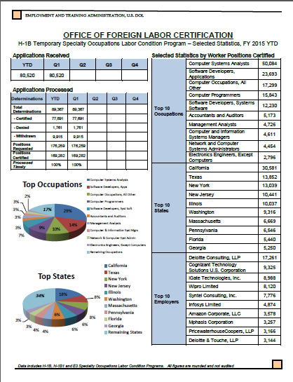
Other Comprehensive Information
Quarterly Selected Statistics Reports
The Office of Foreign Labor Certification provides program factsheets available displaying key selected statistics about each of our major immigration programs.
Permanent Visa Program
Temporary Visa Programs: H-1B, H-2A, H-2B
Prevailing Wage Determination
These factsheets include cumulative information and are updated on a quarterly basis.
http://www.foreignlaborcert.doleta.gov/performancedata.cfm
Example
ETA-OFLC-Performance Management Unit

Slide 7
References
Disclosure Data User Guide: www.foreignlaborcert.doleta.gov/pdf/how_to_use_the_disclosure_data.pdf
OFLC Performance Data webpage: www.foreignlaborcert.doleta.gov/performancedata.cfm
Labor Certification Registry: icert.doleta.gov/index.cfm?event=ehLCJRExternal.dspLCRLanding
ETA-OFLC-Performance Management Unit

